Slide 1
Advancing practice in the care of people with dementia

Slide 2
Session 6a
Therapeutic communication
Learning outcomes:
Discuss therapeutic techniques in communication with the person with dementia
Reflect on your own communication style and its impact on the person with dementia
Assess the patterns of information flow between the health professional and client
Begin to understand the journey of dementia for the clients
Apply your knowledge of dementia to an education plan for your clients
Analyse your own reactions to the observed behaviour of your clients
Assess the need for referral for support networks and facilitate client contact with these networks
Plan for ongoing assessments and client support for decision-making

Slide 3
Communicating with people with dementia
Communication:
The exchange of thoughts, messages or information

Slide 4
Why we communicate
To share information and ideas
To express feelings
To articulate our needs
To meet our needs for social and emotional health
To control, exert power, manage
To meet the needs of others
As a therapeutic tool
(Adapted from Piestro and Ostini, 2003)

Slide 5
How we communicate
Human beings communicate in various ways
One or more of our five senses are involved when we communicate
We use our whole body to communicate
Words, actions, tone of voice, facial expression, language, context

Slide 6
Communication changes in dementia
Word finding
Fluency
Conversation skills – interrupting, not responding, ignoring other speakers, become self-centred
Reduced ability to understand and interpret what is being said
Writing and reading skills altered
Expression of emotions
Co-existing hearing and vision problems
Mute

Slide 7
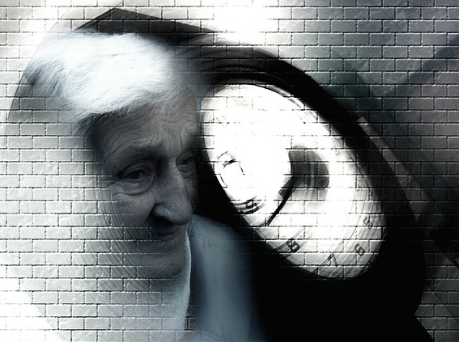
Over-time
Communication will change from verbal to mostly non-verbal
The person will need to communicate more with behaviour than with words
The task of the care giver is to interpret what is being communicated

Slide 8
When communicating with people with dementia
Always:
Disengage person from their current activity or point of focus
Re-direct attention to yourself
Re-engage person

Slide 9
Your role in communication
Be flexible – everyone is different.
Accept that most of the adjustments have to be made by you
Be positive and concentrate on the person’s remaining abilities
Maintain the person’s self esteem – feelings and emotions are preserved
Learn how to listen to and affirm the person’s feelings
Optimise the environment for communication
Ensure the person has access to sensory aids (glasses/hearing aids)

Slide 10
Strategies for communication
Rephrasing things may help
Use orientating names/words wherever possible, e.g. “Your daughter Mary”
Ask them to describe information about a word they cannot find.
Give clues to a word they cannot find
Give clear, simple instructions
Use closed questions
Rely on non-verbal cues – voice, touch, movement, body language
Recognise non-verbal cues from the person to determine emotions

Slide 11
Activity
Discuss other communication strategies you have used in the care of people with dementia.

Slide 12
Session 6b
Dementia friendly environments
Learning outcomes:
Understand what is meant by a dementia friendly environment
Understand how the experience of dementia relates to design
Understand the principles of good design for dementia care
Understand how to apply the principles of good design
Highlight the current controversies and issues in environments and design relating to the care of people with dementia
Access relevant and evidence-based resources
Debate the current controversies surrounding creating friendly environments.

Slide 13
Dementia friendly environments
A cohesive system of support that recognises the experiences of the person with dementia and best provides assistance for the person to remain engaged in everyday life in a meaningful way (Davis et al., 2009)

Slide 14
Design principles
Compensate for disability
Maximise independence, reinforce personal identity and enhance self-esteem
Demonstrate care for staff/carers
Be orienting and understandable
Welcome relatives and the local community
Control and balance stimuli
(Fleming, Crookes & Sum, 2008)

Slide 15
Elements
Colour
Lighting
Interior surfaces, pattern and texture
Fixtures and fittings
Furniture and furnishings
Gardens and outside spaces.

Slide 16
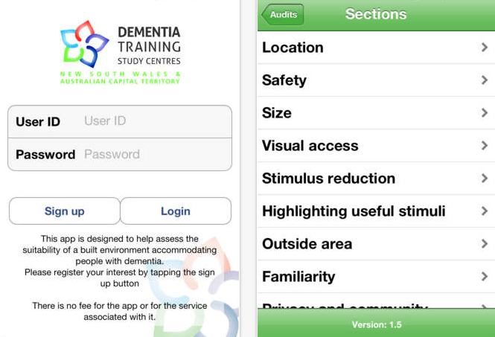
Assessing the Environment
Built Environment Assessment Tool- Dementia
Available as an App through the itunes store

Slide 17
Activity
Case Study: Genevieve’s Experience
How do staff fit into Genevieve’s ‘starting the day’ routine?
How does the social environment (philosophy of care) support Genevieve’s experience?
How does the physical environment support Genevieve’s experience?
What components of the environment might have to change to better support Genevieve as her dementia progresses further?

Slide 18
Case Study: Genevieve’s Experience
Take a moment to reflect on Genevieve’s experience of starting the day in the residential care facility in which she now lives…
Snuggled up in her pale yellow thick and fluffy robe, the staff find Genevieve sitting in her comfy armchair by the bedroom window most mornings when they bring in her coffee and toast. For fifty-three years her husband brought her coffee and toast in bed every morning when he got back from early morning milking. Very seldom did she have to help with the morning milking—she would sit in bed or in the chair by the window and listen to the morning news on the radio and finish her coffee and toast, then she would make breakfast and get the children ready for school. Staff knew how Genevieve liked to start her day. Coffee and toast at the window watching the birds and looking at the garden. Then a quick shower—water is a precious thing, she would say every time. Only Sunday morning before church service was a bath on Genevieve’s agenda. Then she would get dressed and make her way to the kitchen to help wash up the dishes and then often out for a wander round the garden. Staff would slip into the bathroom and get it ready while Genevieve was picking out her clothes. She had a bit of difficulty lately so they had taken to putting only a couple of distinct selections in the front section of the wardrobe—a dress, a cardigan, a blouse, a skirt, one set of underwear and so on. The bathroom was ready…lemon eucalyptus scent her daughter said reminds her of the farm, the towel rack warmer on for the pale yellow towels with tiny embroidered roses in the corner so they were nicely warmed when Genevieve stepped out of the shower.
Genevieve’s take on the experience ….
There is that nice girl that comes and gives me a hand with that new-fangled shower. I must have my shower now – umm…that sweet smell of the lemon eucalypt coming through on the wind…must be a southwest wind this morning. My towel…there it is – nice and warm. I must sort out that garden today so I’d better have my cardi first thing. I’ll sit here – can you brush my hair? Well there’s a surprise – look who is here in the mirror – Nanna? Have you met my Nanna? Yes she is lovely, you’re quite right. Is the back of my hair all right?

