Slide 1
Good Spirit, Good Life
Kate Smith and Kevin Taylor
Centre for Aboriginal Medical and Dental Health, School of Indigenous Studies
University of Western Australia
Lianne Gilchrist, Harry Douglas, Kate Bradley, Dina LoGiudice, Leon Flicker, Julie Ratcliffe, Christine Clinch, Paula Edgill, Carina Petersen, Shondell Hayden, Zoe Hyde, Dawn Bessarab
GSGL Elders governance group, Service Provider Advisory Group
Notes:
developing a resource to identify and address the wellbeing needs of older Aboriginal Australians
I have a big team around me, some of whom are here today supporting me, so I’d like to acknowledge all of their work on to the study.

Slide 2
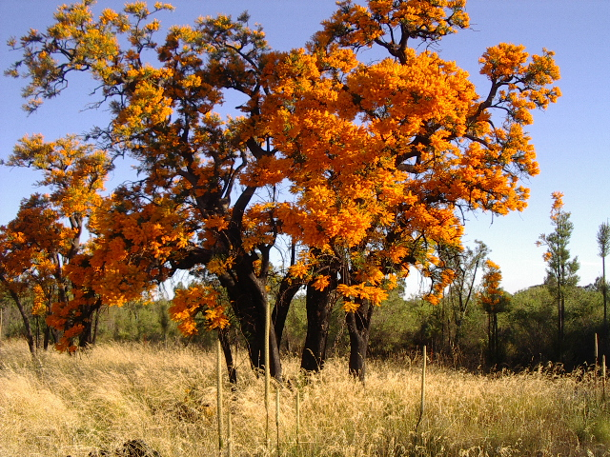
Welcome and Acknowledgement of Country
Notes:
I acknowledge the Wadjuk people as the Traditional Owners of the land on which we meet today, and pay my respects to the elders past and present.

Slide 3
Background
Quality of life is defined by the World Health Organisation as “an individual’s perception of their position in life in the context of the culture and value systems in which they live, and in relation to their goals, expectations, standards and concerns.” (The WHOQOL Group, 1995)
Optimising Quality of Life is the primary policy objective of the Federal Government for people receiving sub-acute and aged care services. (Productivity Commission, 2011. Department of Health & Aging, 2012)
Australia’s Aged Care Quality and Safety Commission – new quality standards.
Consumer dignity and choice including:
Quality standard 1:
each consumer is treated with dignity and respect, with their identity, culture and diversity valued;
care and services are culturally safe;

Slide 4
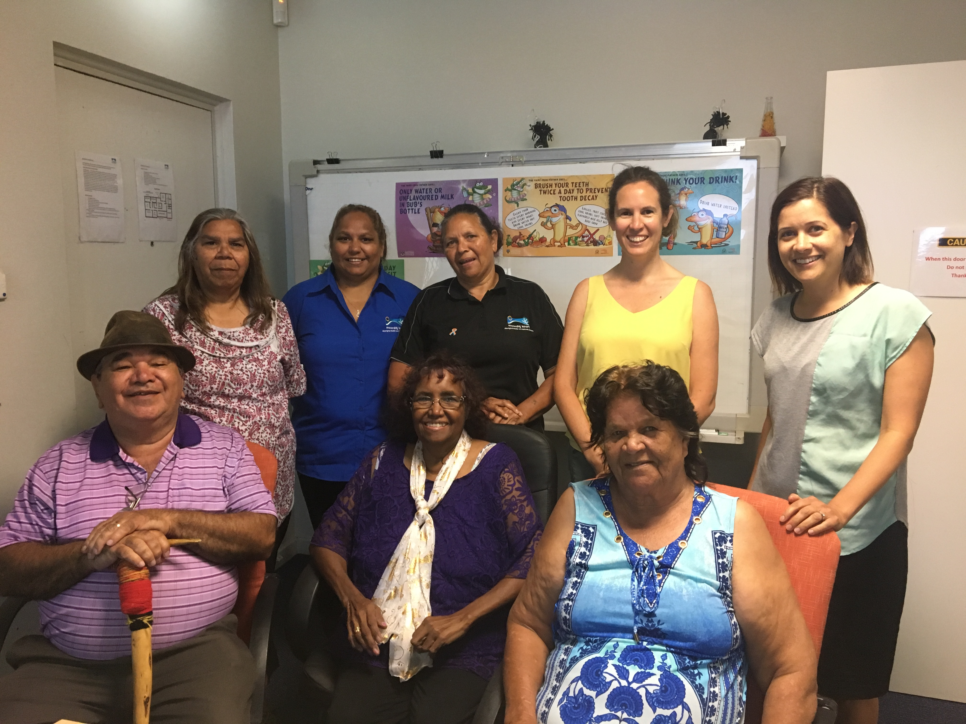
Background
There is no quality of life tool specifically developed for older
Aboriginal Australians, or older Indigenous people internationally
(Angell et al 2016).
Quality of life tools are used by health and aged care services to identify
client’s wellbeing needs and to evaluate strategies over time.
Aims:
To develop and validate a Good Spirit, Good Life package that includes:
A quality of life tool for older Aboriginal Australians with and without cognitive impairment,
Strategies and recommendations from older Aboriginal people
Increase the number of Aboriginal researchers working in dementia research
Notes:
Our study has come about because at this stage there is no quality of life tool specifically developed for older Aboriginal people in Australia. WE know that a person’s perception of their quality of life is dependent on their culture and values and that QOL priorities can differ between older and younger people. WE also know that the purpose of quality of life tools in health and aged care is to identify and address a clients wellbeing needs and evaluate strategies over time. (measures changes)

Slide 5
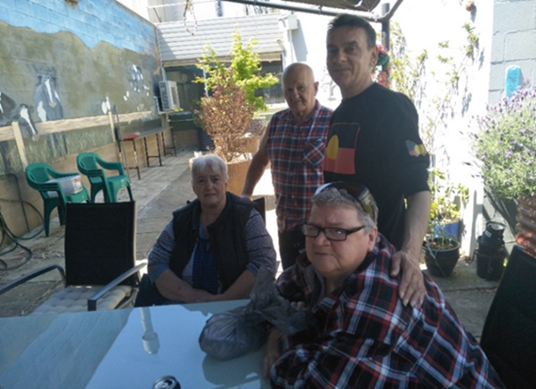
Internationally Healthy spirit = Quality of life
Good Spirit Good Life participants and Elders group preferred the term ‘a good life’.
Good spirit (Moorditj Wirrin) is central to having a good life and being healthy.
“If our spirit’s broken, we become sick. Our spirit’s sick and how can we heal it,
if we don’t have that quality of life?” ( Interview 10, F 63 yrs)
The centrality of spirit to wellbeing is a shared notion for Indigenous peoples internationally.
“Spirituality defines the relationships of Indigenous peoples with their environment as custodians of the land; it helps construct social relationships, gives meaning, purpose and hope to life. It is not separated but is an integral, infused part of the whole in the Indigenous worldview. It is important to realise that a healthy spirit is essential for Indigenous people to live a healthy life”
(Kipuri, 2009)

Slide 6
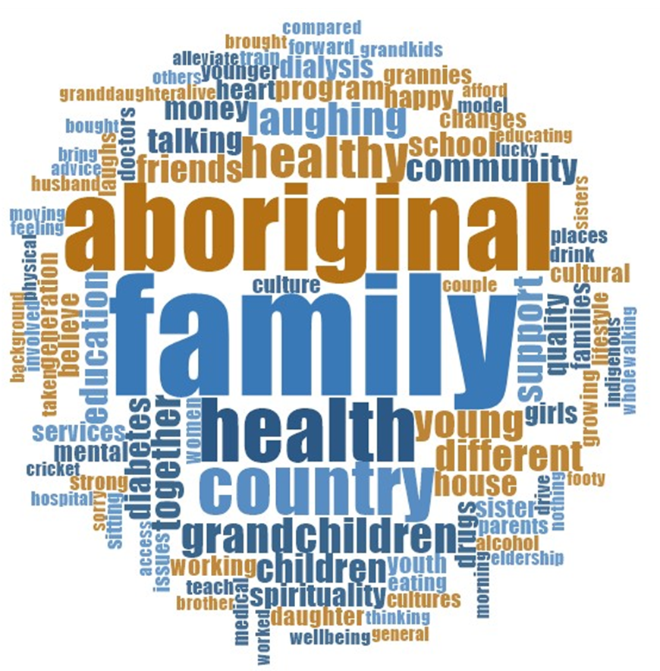
Methodology
Mixed methods approach - tool development is qualitative, validation of tool was quantitative.
Indigenous research methodology: Participatory Action Research (PAR) method grounded in Indigenous Worldviews.
Recruitment of participants through Aboriginal Health and Aged Care Service partners.
Interviews completed in a yarning style and participant narratives were analysed thematically by Indigenous Researchers.
Triangulation of data with Indigenous and non-Indigenous researchers for methodological rigour.
Further triangulation through consultation with Elders from the Aboriginal Advisory group and yarning groups with participants in Perth and Melbourne.
Notes:
PAR methodology is used to actively involve participants in the development of the package – responding to recommendations and acting on these.
Indigenous worldviews – identifying what QOL means for older Aboriginal people

Slide 7
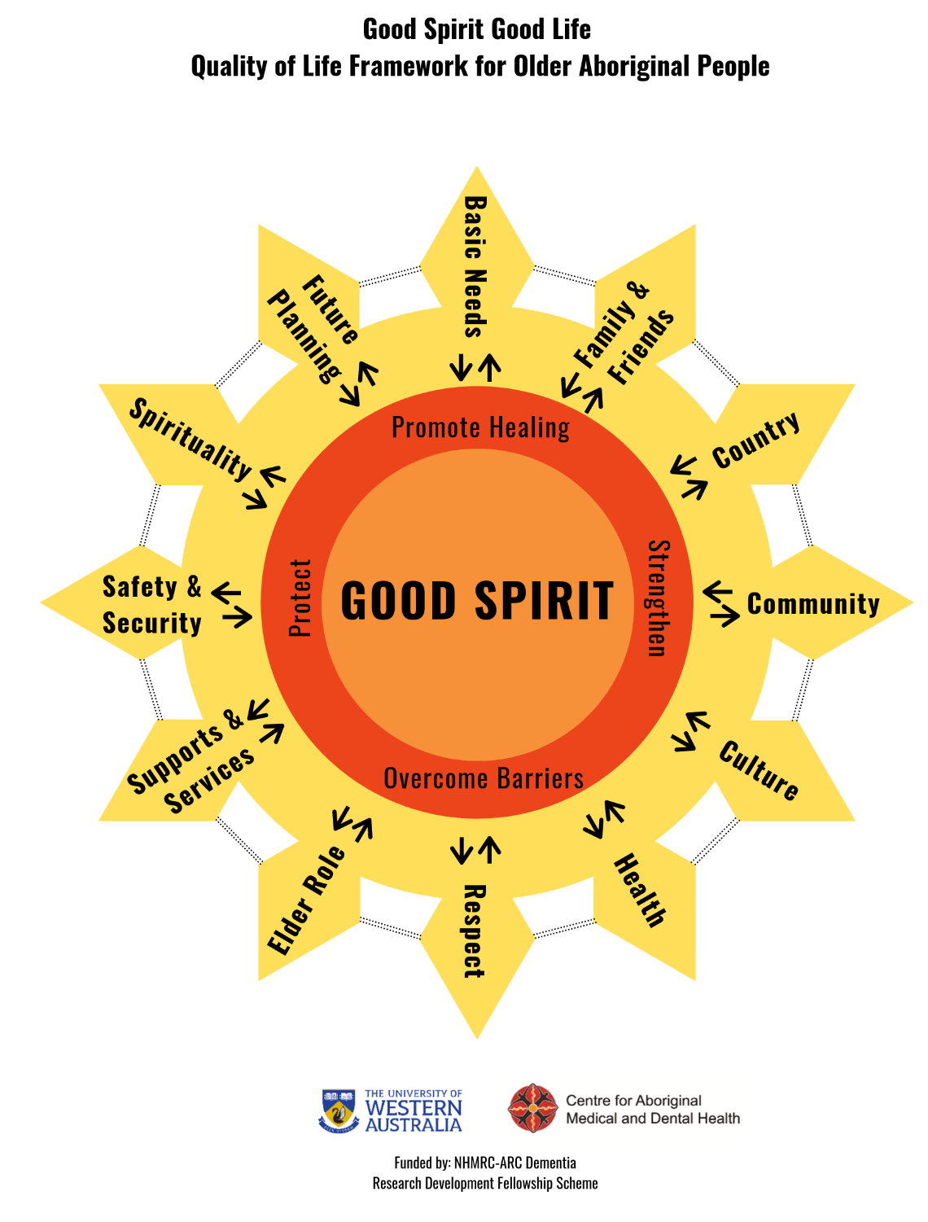
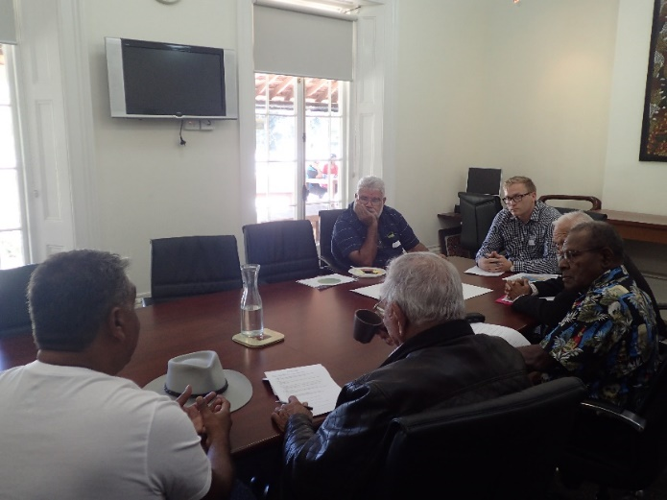
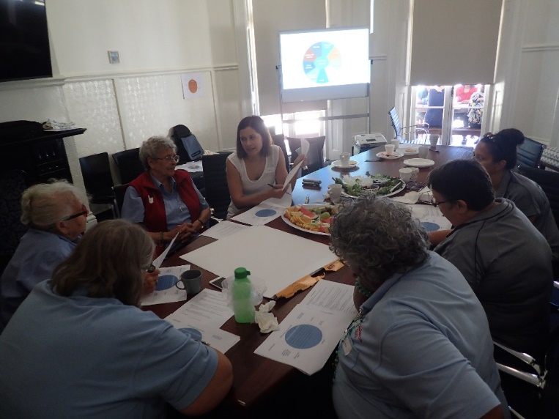
Good Spirit Good Life Framework
Most important thing for me now, to keep my health, so I can look after my grandchildren…I wanna watch my grandchildren grow”
I would like to have a roof over my head and a nice bed to sleep in and food on the table every day. Just the basics of living.
“We’ve got to have access to our youngsters, to be able to teach them the old way, and to make sure we don’t lose it.”
“Just when I die, I’d like them to take me back to my town to bury me”
Ref: Smith K, Gilchrist L, Taylor K et al. "Good Spirit, Good Life: A Quality of Life Tool and Framework for Older Aboriginal Peoples." The Gerontologist (2020).
Notes:
From our interviews we were able to identify 12 main factors important to the quality of life of older Aboriginal people and what we found was an underlying theme of connection to the inner spirit and interconnectedness of the various factors. The factors important to having a good life for older Aboriginal people were the importance of family and friends, connection to country, connection and belonging to the Aboriginal community, the importance of knowing and identifying with aboriginal culture and being involved in cultural activities, maintaining health, respect, the elder role, being able to access respectful and culturally safe supports and services, having safety and security, expressing spiritual and cultural beliefs, being able to plan for the future and having basic needs met. expressing spiritual and cultural beliefs and being supported in practices such as going to church to paying respects at funerals, being able to access respectful supports and services, and having safety and security for the older person and their families.

Slide 8
Context of lived experiences Barriers to quality of life
Barriers to strong inner spirit
racism
Past government policies/ colonisation
poverty
substance abuse
suicide
lack of security
elder abuse
carer strain
Lack of culturally responsive services
Lack of respect
Housing issues
“The youngest one was the one that was taken, and we never found her…it was great to hear Kevin Rudd say sorry.”
“[The monk] “he’d come give you a strap across the back. You know what they use for the horses, the reigns? They’d double them up, you know... we’d have big blue marks across our backs and everything.”
“It is racist so it’s very hard. It’s really, really hard. Cause I know when I go to the shops I’m watched.”
The structure of residential care may trigger past traumas.

Slide 9
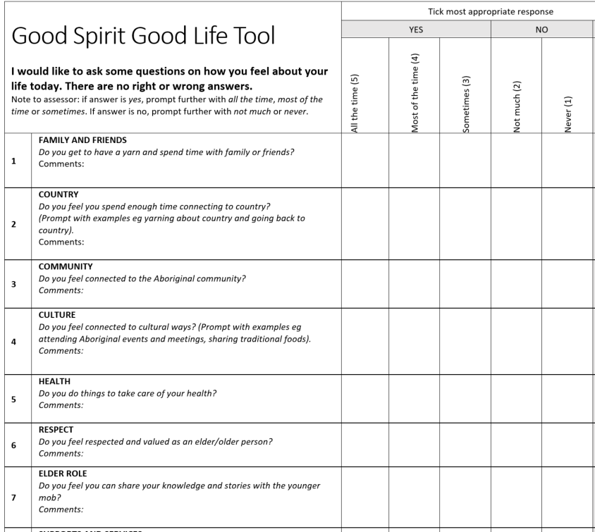
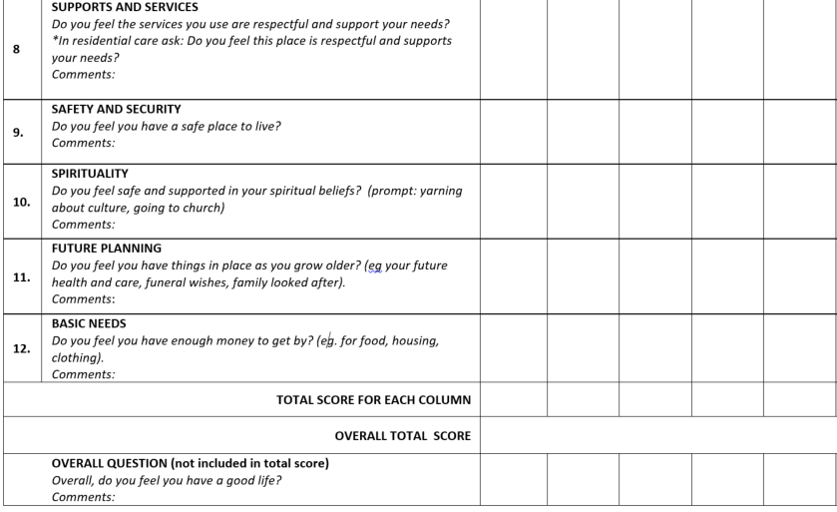
Good Spirit, Good Life Tool
Notes:
So as you can see we have a 12 item Good Spirit Good life tool with a 5 point response scale. If a person’s responses are in the not much or never columns, this is when we would recommend putting strategies in place to address that person’s wellbeing needs in those areas.

Slide 10
Validity Results
Inter rater reliability:
All 12 questions had good to excellent agreement.
Intraclass correlation ranged from 0.69-0.95.
Validity:
120 Aboriginal people aged 45-86 years
68% were women.
The mean total GSGL score was 48.7/60.
11% of participants had cognitive impairment or dementia.
GSGL internal consistency Spearman-Brown 0.83, Cronbach’s alpha 0.75

Slide 11
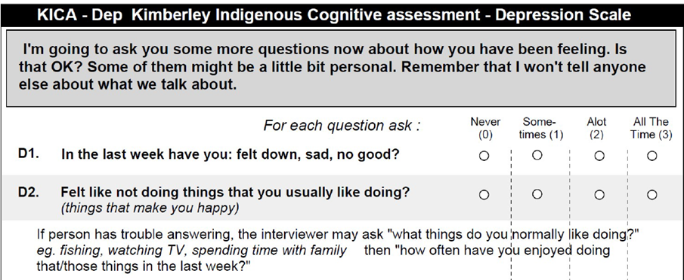
Known groups validity
Supported by significant difference in GSGL scores between
Participants with (40%) and without anxiety (Student’s t test t=4.3, p<0.05) and
Participants with (44%) and without depression (t=4.1, p<0.05).
GSGL scores did not differ significantly for participants with and without cognitive impairment.

Slide 12
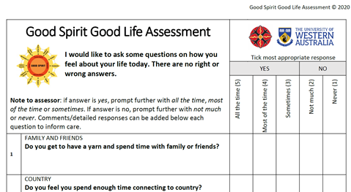
Factors associated with GSGL
Following multivariable linear regression, associations with total GSGL score (Better quality of life)
Resilience (ARRQ-25 β=0.55, 95%CI [0.39, 0.70])
Low anxiety (GAI-SF score β=-0.22, [-0.38, -0.06])

Slide 13
Item analysis
Lowest item-total correlation for
Supports and services (ques 8, 0.31)
Highest item-total correlation for
Respect (ques 6, 0.65)
Elder role (ques 7, 0.65)
Culture (ques 4, 0.62)
These 3 items are best indicative of the overall score of the tool, ie. the person’s overall quality of life

Slide 14
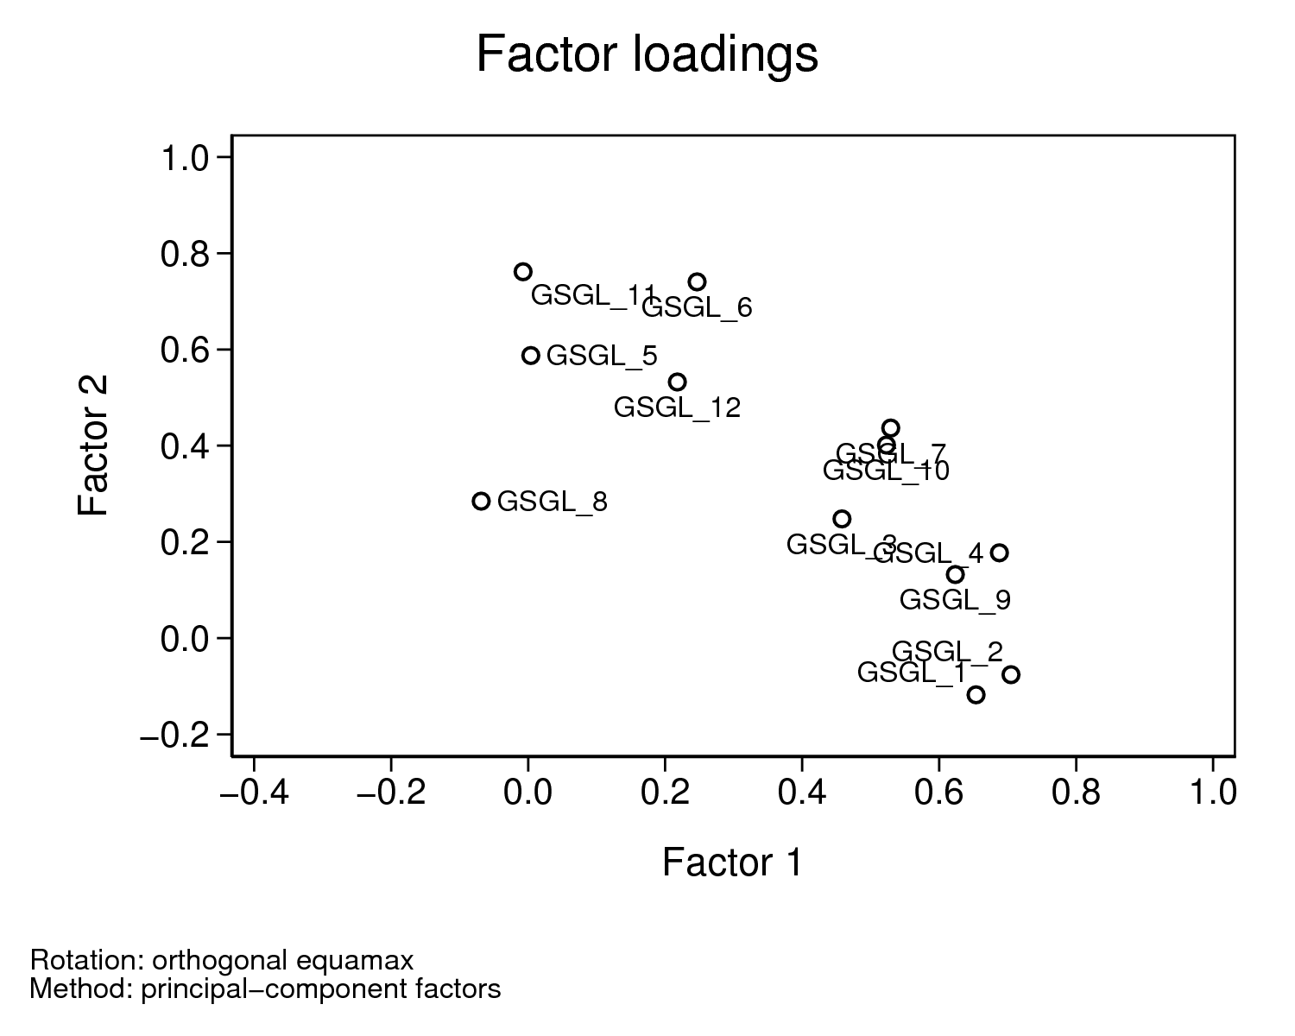
Factor analysis
Rotated factor loadings (pattern matrix) and unique variances
-------------------------------------------------
Variable | Factor1 Factor2 | Uniqueness
-------------+--------------------+--------------
GSGL_1 | 0.6539 | 0.5585
GSGL_2 | 0.7049 | 0.4974
GSGL_3 | 0.4581 | 0.7287
GSGL_4 | 0.6879 | 0.4953
GSGL_5 | 0.5874 | 0.6549
GSGL_6 | 0.7406 | 0.3907
GSGL_7 | 0.5293 | 0.5291
GSGL_8 | 0.2847 | 0.9143
GSGL_9 | 0.6236 | 0.5936
GSGL_10 | 0.5231 | 0.5654
GSGL_11 | 0.7616 | 0.4200
GSGL_12 | 0.5324 | 0.6691
-------------------------------------------------
Supports and services
Factor 1: family and friends (1), country (2), community (3), culture (4), Elder role (7), safety (9), spirituality (10)
Factor 2: health (5), respect from others (6), supports and services (8), future planning (11), basic needs(12)

Slide 15
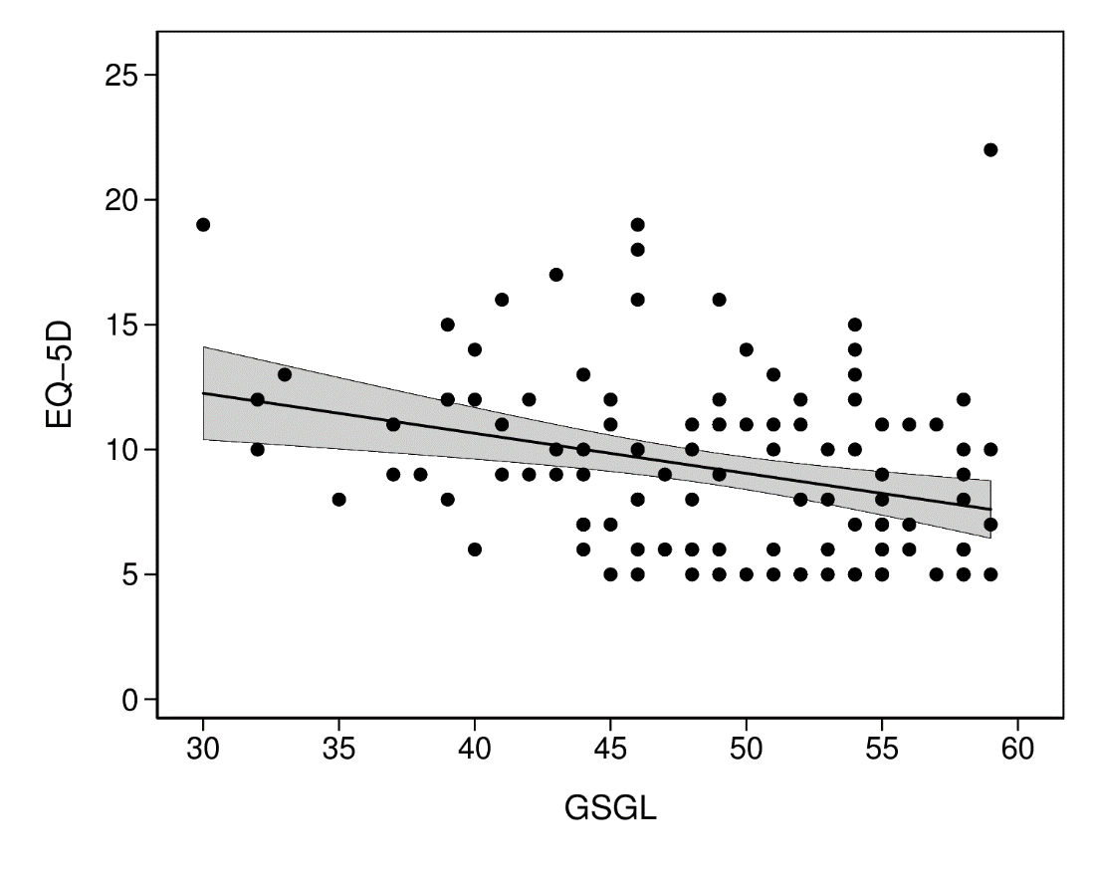
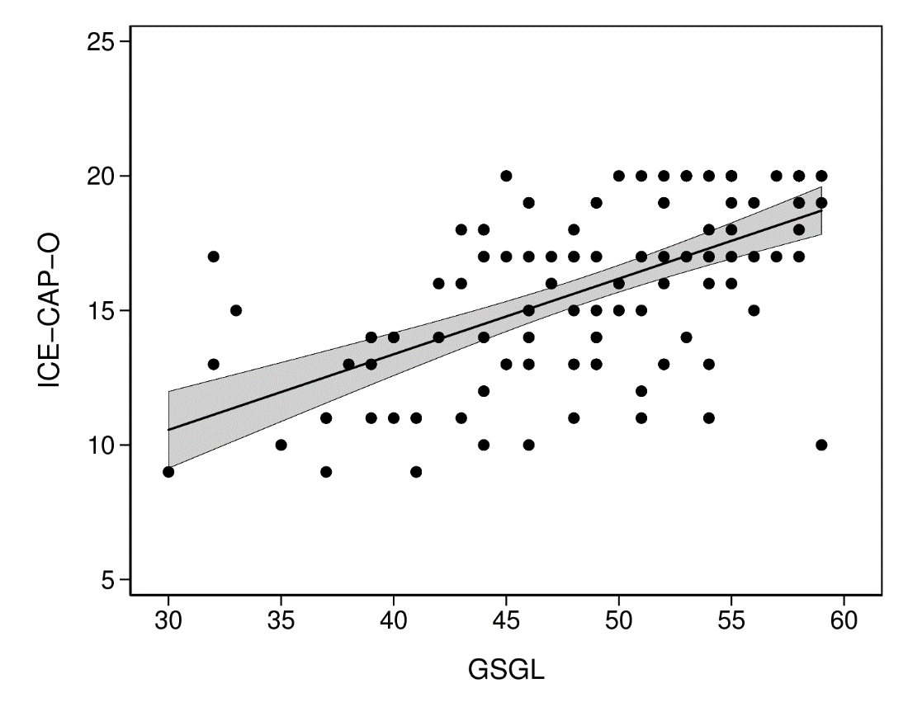
Concurrent Validity Supported
EQ5D (mobility, self-care, anxiety, pain, activities) weak negative correlation with GSGL Spearman’s rho = -0.32.
Not holistic, deficit focused. May add different information.
ICECAP-O (friendship, future, value, enjoyment, independence) strong positive correlation with GSGL Spearman’s Rho (ρ)=0.61, p<0.05.
Feedback that ICECAP-O questions were unusually worded (“winyarn”).

Slide 16
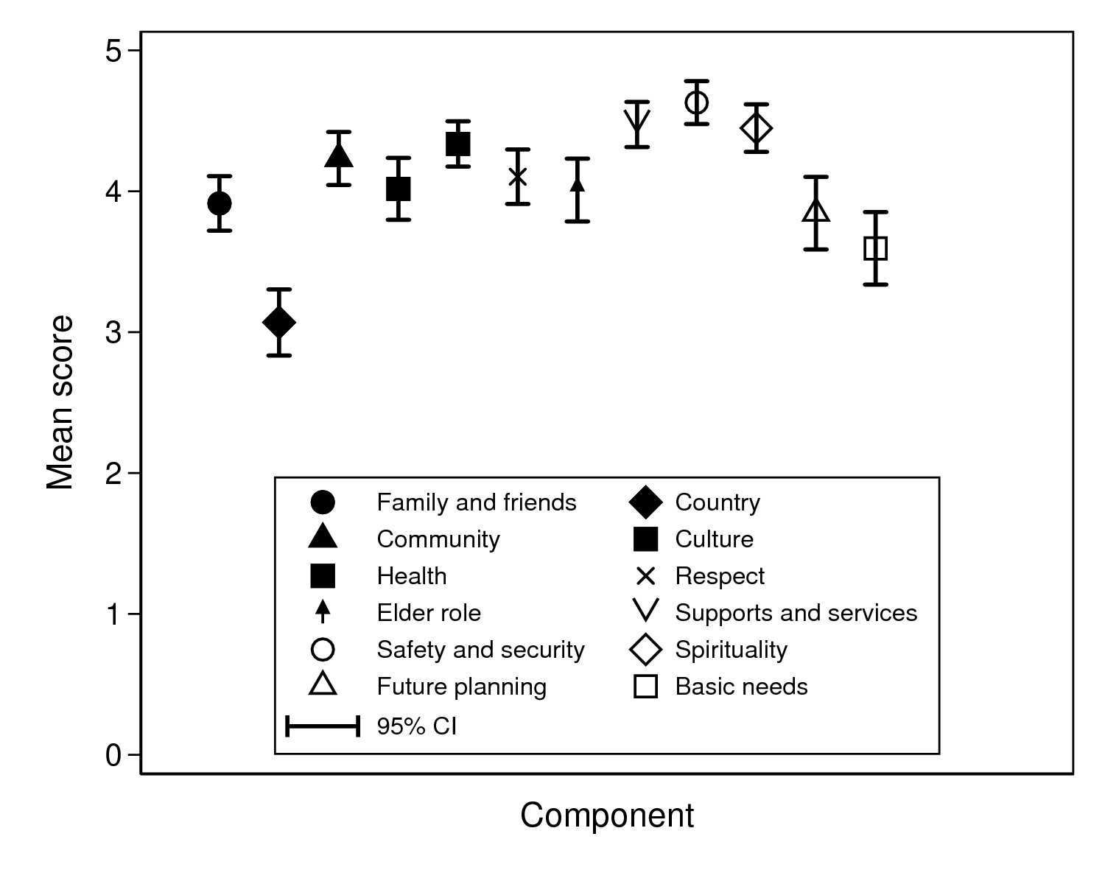
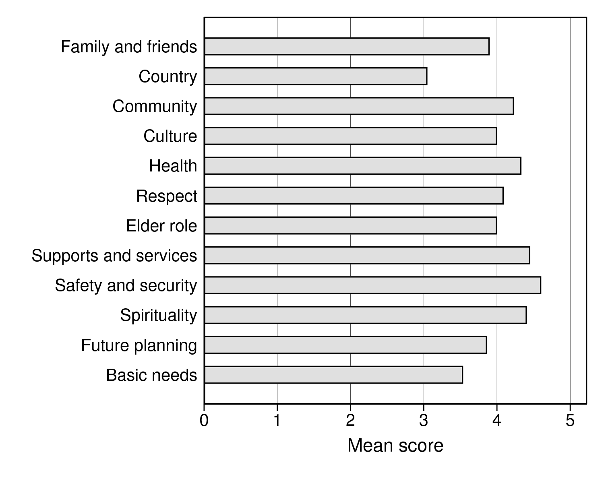
Quality of life domains
Domains most likely to be met:
Safe and secure housing (x̄ 4.6/5, sample bias),
Respectful support and services (ACCOs, x̄ 4.5/5)
Feel supported in spirituality (x̄ 4.4/5)
Domains least likely to be met:
Connection to country (x̄ 2.9/5)
Basic needs (̄x̄ 3.6/5)

Slide 17
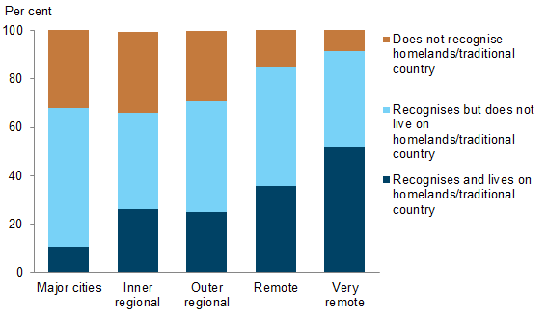
Connection to Country
Connection to country is a priority of older Aboriginal peoples.
Loss of connection: displacement - past policies, Stolen Generation, need for health and aged care, employment
There was significant difference in GSGL item scores (p<0.05; Hotelling’s T² test),
‘Country’ item had the lowest mean score (3.05/5, p<0.05).
“Being in touch with your environment and mother earth, it’s very important to us. I don’t know if they do those little trips to different places but it would be good I think. That helps a lot of people, Aboriginal people you know …I know I feel different when I go home, just feeling my spirituality topping up”.
Indigenous adults who recognise and live on homelands or traditional country, by remoteness, 2012–13
(AIHW 2015)

Slide 18
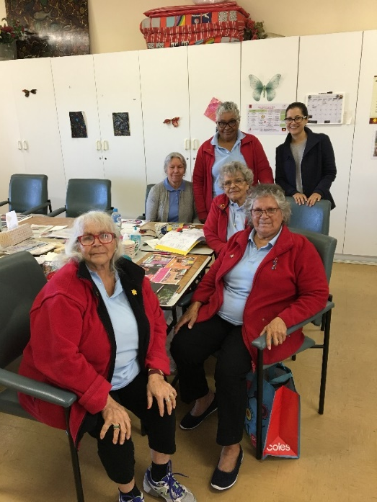
Recommendations
Based on information shared in interviews, yarning groups and advisory groups
User friendly, quick reference with practical suggestions
Addresses each item important to having a good life
Country
Support older person to spend more time on Country or return to Country if this is their preference.
Take day trips to national parks, country towns, cultural centres with group - elders sharing stories and experiences
Engage in activities that promote connection and caring for the land eg painting/art, gardening, yarning sessions with others
Service providers can develop and create tranquil garden areas – incorporate native plants and bush tucker.
Set up environment – have a fire pit, use photos or artwork to encourage yarning about country.
Encourage simple activities such as removing shoes and taking walks outside to support the older person to feel more connected to the land.
Assist with transport, consider any access issues and management of medical needs.
Use of technology to connect Elders with Country

Slide 19
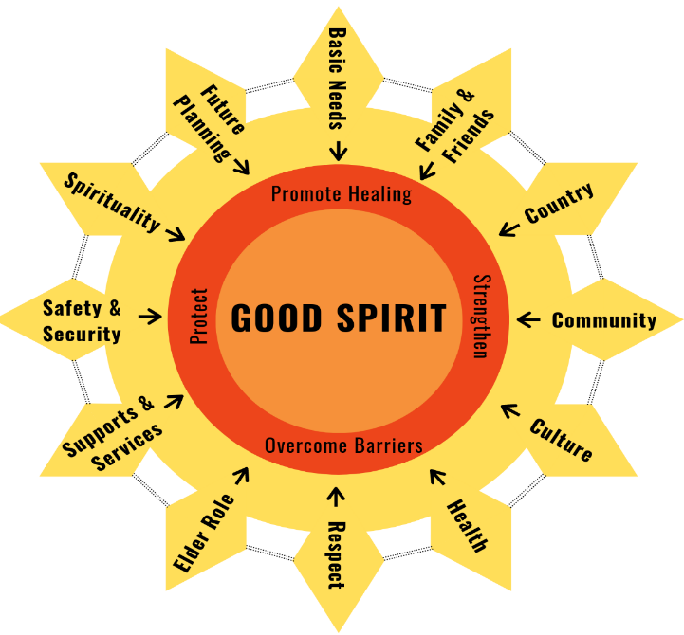
Conclusion
The GSGL is a culturally valid tool for measuring quality of life in older Aboriginal Australians.
Connection to Country needs are not being sufficiently met by service providers and carers- More needs to be done, however all factors important and interconnected.
Respect from others, Elder role and Connection to Culture questions
Do you feel respected and valued as an elder/older person?
Do you feel you can share your knowledge with the younger mob?
Do you feel connected to cultural ways?
These are important questions to identify an older person’s level of wellbeing.
Improving the quality of life of older Aboriginal Australians through the 12 interconnected factors may
build resilience/promote healing and
reduce anxiety and depression in older Aboriginal Australians
Tool is developed for people living in urban/regional areas.
Will need adaptation for people from or living in remote areas and Torres Strait Islander people.
Notes:
Do you feel respected and valued as an elder, Do you feel connected to cultural ways?
Enhance QoL through involving elders in decision making, cultural training, respecting person in their elder role. Facilitate connection to cultural identity and activities.

Slide 20
Future directions
Disseminate
Dissemination of results and development of training packages as required
Translate
Embed Good Spirit Good Life package in aged and health care policy and practice, to enhance the wellbeing of older Aboriginal Australians with and without dementia
Stakeholder launch of the Good Spirit Good Life tool and recommendations
www.aboriginalageingwellresearch.com
Notes:
Our next stage is to complete our overall validation of our tool with 100 participants across Perth and Melbourne
Once we have all our results, we plan on sharing these, we’re currently writing a paper on the development of the tool, developing a training package and launching the good spirit good life tool and recommendations. We are then hopeful that this information can be used to inform government policy and aged care service delivery to enhance the wellbeing of older aboriginal people.

Slide 21
Thank you to our Participants and Elders Group Members
Notes:
Finally, a big thank you to all our participants, elders group members and service provider partners.

