Slide 1

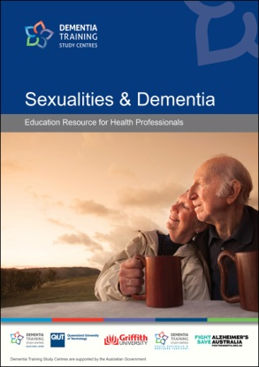
Sexualities & Dementia
Workshop Facilitator: Dr. Cindy Jones

Slide 2
INTRODUCTION
Brief introduction to Workshop Facilitator
Ice-Breaker Activity:
  Participants Introduction (name, area of discipline & what you hope to achieve from this workshop)
  Come up with a word or a short phrase to describe sexuality & ageing

Slide 3
WORKSHOP AGENDA & OBJECTIVES
General Housekeeping
Objectives - Increase awareness & understanding of:
The intimate & sexual needs of PWD
The importance of expression of sexuality for PWD
The role of health care professionals in responding to the expression of sexuality by PWD
A model to assess cognitive competency of PWD to have intimate & sexual relationships
A framework to better support the expression of sexuality by PWD
Knowledge translation of sexualities & dementia into care practices

Slide 4
MODULE A
Intimacy, Sexuality and Sexual Behaviour
Unit I: Defining Intimacy, Sexuality and their Significance to Well-being

Slide 5

ACTIVITY
Brainstorm the difference between intimacy & sexuality?

Slide 6
Meaning of Intimacy & Sexuality
Exist in all relationships – the drive for intimacy & sexuality exists in all individuals
Not easily defined – depends on the individual

Slide 7
Intimacy
  Refers to the experience of connecting with another based on feelings of care & affection
  Trust, choice, security, & reciprocity
  A desire to have companionship, ‘a shoulder to lean on,’ & thus be free from loneliness
  Different levels of intimacy (Moss & Schwebel, 1993):
Mutual | A process of exchange
Physical | Sharing space with another to sharing body contact and/or sexual activities
Cognitive | Sharing ideas, information, values & goals
Committed | An ongoing process of connecting, being close & sharing personal truths
Emotional | Showing a deep positive regard for the other, care & compassion

Slide 8
Sexuality
The socially constructed roles, behaviours, identities and processes – prescribed and prohibited, enacted and avoided, admitted and denied, valued and devalued, relational and non-relational – associated with female and male eroticism, reproduction, sex acts, thoughts, feelings, beliefs and attitudes. It refers specifically to those aspects of sensual, psychosocial and physical stimuli and responses associated with the pleasure and pains, fulfillments and humiliations of the person in the name of sex. It is broader than, but includes, the acts of sex and being female and male. (Nay, 1993; pg. 199)

Slide 9

The World Health Organisation defines sexuality as “a central aspect of being human throughout life and encompasses sex, gender identities and roles, sexual orientation, eroticism, pleasure, intimacy and reproduction” (2002; pg. 5).

Slide 10

SEXUALITY, AGEING & DEMENTIA
Gender Identities & Roles
Affection
Romance
Intimacy
Penetrative sex acts
Sensuality
Eroticism
Relationships
Companionship
Sexual Orientation

Slide 11
Sexuality
  Multi-layered construct
  Not limited to the physical ‘sexual’ acts
  Include psychological & social components
  Integral to identity & reflects personhood
  Key feature is the need for intimacy
Ageism - sexuality remains a sensitive & taboo topic
Actual practice of sexual intercourse may change with age
Fundamental need for expression of sexuality remains – even for older people & people with dementia (PWD)
The term “Sexualities” will be used in various context – LGBTI community

Slide 12
Difference between intimacy & sexuality
  Intimacy reflects how relationships with others are formed & maintained.
  Sexuality reflects an individual’s identity & how individuals present themselves to the world & the roles that are taken on.
    Multiple ways of expression
    An individual can be sexually intimate with another as an expression of sexuality BUT not a defining feature of an individual’s sexuality & not the only way one is able to engage in intimate relationships.

Slide 13
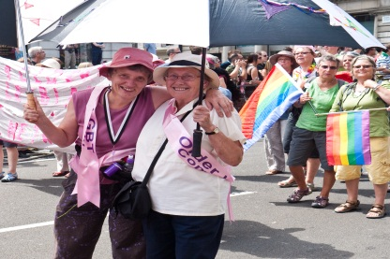
Types of Sexuality & Sex /Gender Identities
Editorial Credit: Padmayogini / Shuttlestock.com
Heterosexuality = sexual, emotional, and/or romantic attraction to a person of a sex other than your own
Homosexuality = sexual, emotional and/ or romantic attraction to a person of the same sex
  Lesbian (L) = women who are attracted to women
  Gay (G) = lesbians & men who are attracted to men
  Bisexual (B) = individuals who are attracted to both sexes/genders, but not necessarily simultaneously or equally
Pansexual = fluid sexual, emotional and/or romantic attraction towards people of all biological sexes and gender identities

Slide 14

Trans (T) = may include but not limited to transgender, transsexual, transvestites, genderqueer, cross-dressers and other gender-variant people. Not a sexual orientation or preference, but an umbrella term for individuals whose:
Psychological self (gender identity) differs from the social expectations for the physical sex they were born with. For example, a female with a masculine gender identity or who identifies as a man.
(Holmes, 2003; pg. 7)
Intersex (I)
A set of medical conditions that feature congenital anomaly of the reproductive and sexual system. That is, intersex people are born with sex chromosomes, external genitalia, or internal reproductive systems that are not considered ‘standard’ for either male or female. (Holmes, 2003; pg. 7)
Editorial Credit: Bikeworldtravel / Shuttlestock.com

Slide 15
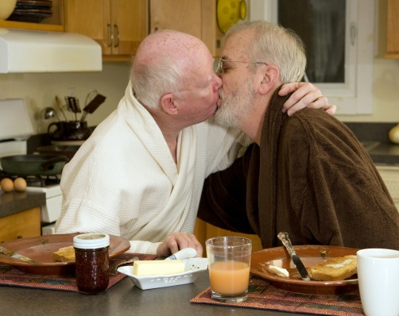
REFLECTIVE QUESTION:
How would you feel about an older gay or lesbian couple coming to talk to you about their sexual relationship or sexual concerns?

Slide 16

Gay & Lesbian Elderly – Photography by Richard Renaldi
Features a series of black & white photographs of older gay & lesbian people in their homes
http://www.renaldi.com/archive/#id=album-20&num=content-658

Slide 17

Movie: GEN SILENT
Sponsored by the Brookline Council on Aging, Goddard House and the LGBT Aging Project, this is an award-winning documentary by filmmaker, Stu Maddux, that follows six Boston-area LGBT older adults over the course of a year as they deal with the challenges of aging and being gay, lesbian, bisexual or trans.
http://stumaddux.com/GEN_SILENT.html

Slide 18
Myths & Facts of Sexuality & Ageing
ACTIVITY
What do you know about sexuality & ageing?

Slide 19
Myths
  Older people are physically unattractive & therefore undesirable
  The idea of older people attempting sexual activities is perverse & disgraceful
  Older people don’t have sex, aren’t interested in sex, can’t have sex & stopped developing sexual relationships

Slide 20
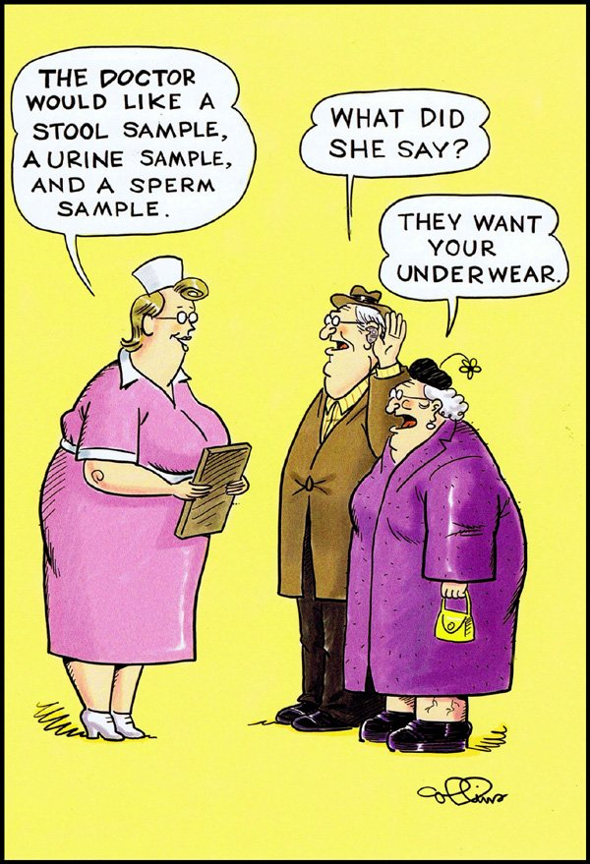
Ageist views: older people
X don’t have sex
X aren’t interested in sex
X can’t have sex
X stopped developing sexual relationships
In reality…
meaningful & important issue
may not express their sexuality (redefine & reprioritise)
want to discuss sexual needs, function & concerns with their health caregivers and part of clinical care
Notes:
Prevailing conventional ageism views older people as asexual and therefore without sexual needs. On the contrary, older people, including those with dementia, continue to be sexual beings with the capacity and need for expression of sexualities. Research literature indicates that the sexual rights of older people are not always supported in long-term care settings. In fact, consultations with older people regarding their sexual needs, desires and concerns are minimal, if they happen at all, as the conventional ageist views about sexualities see care staff and families regarding sexual expression as an activity that should be discouraged.
Staff Attitudes
sexual behaviours are a problem not an expression of a need / uncomfortable with displays of affection/sexual behaviours / become paternalistic / concerned about competency of older people involved / may feel disgusted / level of comfort with GLBTI relationships / uncertain what to do or say

Slide 21
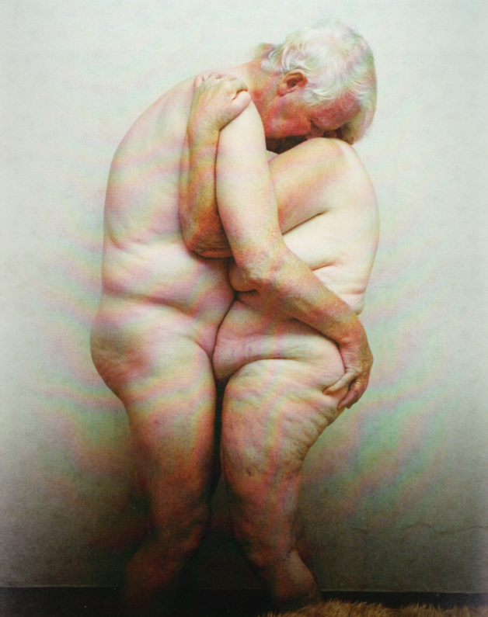
The Health in Men Study of 12,000 Australian man aged ≥ 65
http://www.agedcareinsite.com.au/pages/section/article.php?idArticle=15325
US national study of 1550 women & 1455 men aged 57 to 85
(Lindau et al. 2007)
  Oral Sex
      57 to 75: > 50%
      75 to 85: ≈ ⅓
    Sexually Active
      57 to 64: 73%
      65 to 74: 53%
      75 to 85: 26%
    - Sexual activity decline with age
    - Prevalent sexual problems
      Women: low desire (43%), difficulty with vaginal lubrication (39%) & inability to climax (34%)
      Men: erectile difficulties (37%) - 14% reported using medication or supplements to improve sexual function
75 to 79: 40% sexually active
80 to 84: 30% sexually active (in the past 12 months)
85 to 89: 20% sexually active
90+: 10% sexually active
© Timeless Love by Marie Bot

Slide 22
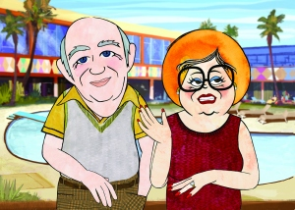
Backseat Bingo
An animated documentary that effectively dispels the societal preconceptions about romance & older adults is available at the website. It is a powerful reminder that love & desire remain an integral part of health ageing & personal well-being.
http://vimeo.com/7584260

Slide 23
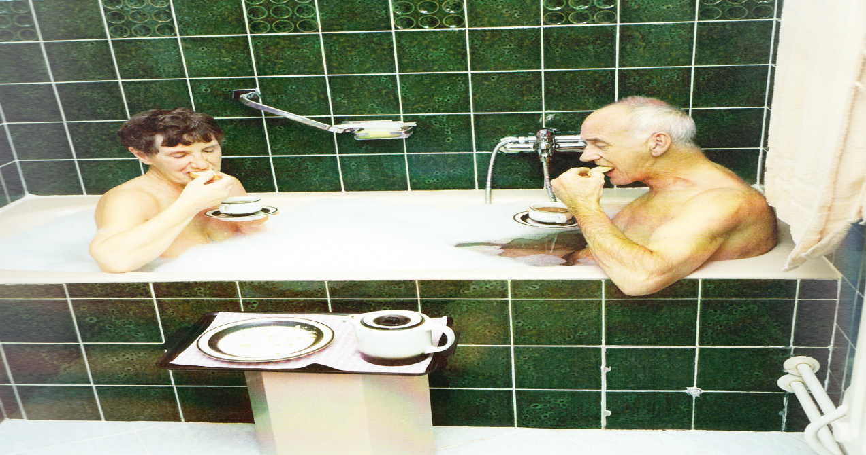

Why is expression of sexuality important for older people?
Quality of life
Identity & personhood
Positive self-concept
Healthy interpersonal relationships
A sense of integrity
© Timeless Love by Marie Bot
If deprived… detrimental effects on social relationships, self-image & mental well-being for older people…
Notes:
Expression of sexuality is important as it is a key attribute to quality of life as well as a significant component of identity and personhood in older people. Furthermore, sexuality is imperative in maintaining healthy interpersonal relationships, positive self-concept and a sense of integrity. If deprived, can have detrimental effects on social relationships, self-image and mental well-being for older people

Slide 24
Timeless Love – Photography by Marie Bot
A photography book of older people making love
“Since the 1970s, we have become accustomed to seeing pictures of nudes in every conceivable context. Even soft porn tableaux in fashion magazines and erotic films on TV no longer have the power to shock – provided that the models are young and good-looking. But we are evidently still uncomfortable with the idea that elderly people can have active love lives and enjoy sex. We would rather not be confronted by such images.” (Online Anonymous Review)
http://issuu.com/bintphotobooks/docs/timelesslovebymarriebot

Slide 25
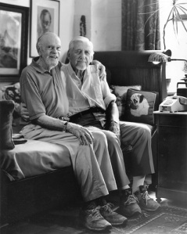
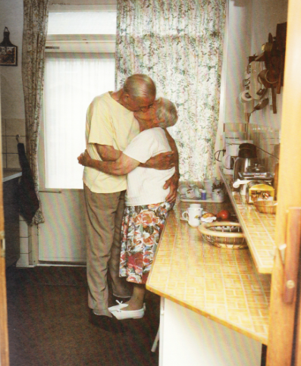
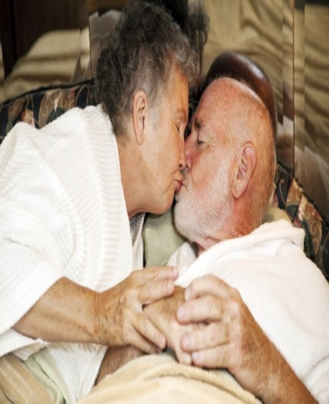
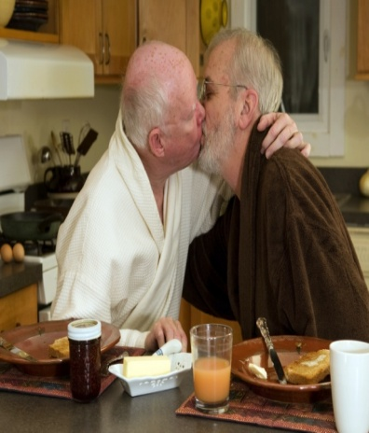
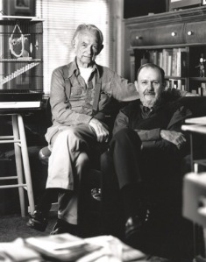
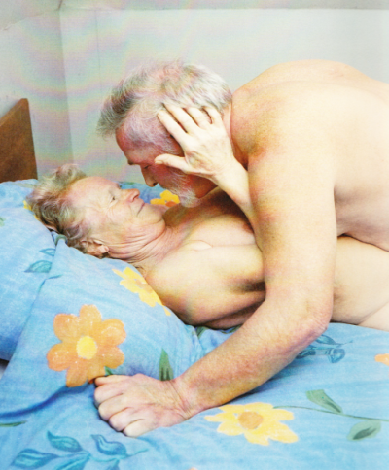
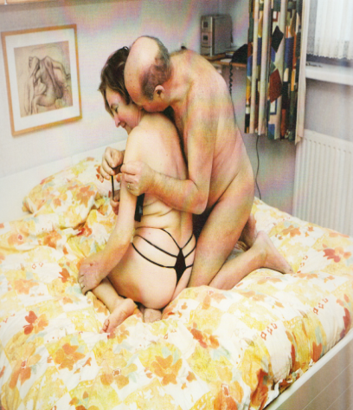
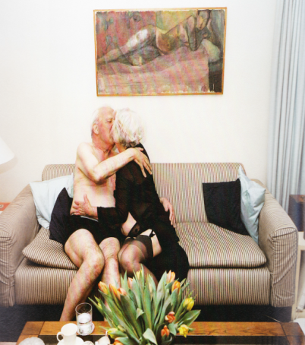
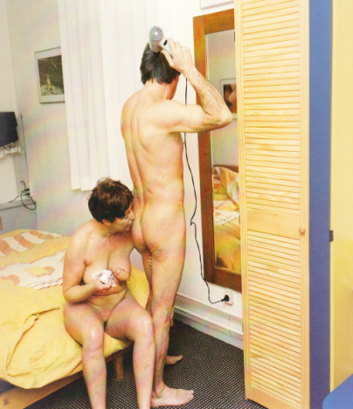
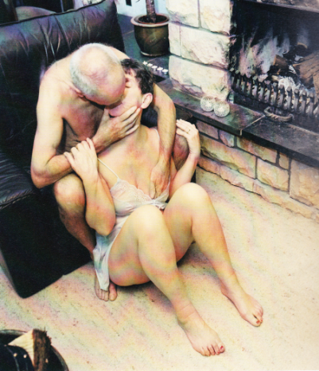

Slide 26

REFLECTIVE QUESTION:
Are you comfortable with discussing the topic of intimacies & sexuality with an older patient or an older person for whom you provide care. Why or why not?

Slide 27
MODULE A
Intimacy, Sexuality and Sexual Behaviour
Unit II: Expression of Intimacy and Sexuality

Slide 28
Concepts of Intimacy & Sexual Behaviour
Healthy intimate & sexual behaviours reflect the human need for loving relationships with oneself & others
Drives for & expressions of intimacy & sexuality are different though
Behavioural indicators of the need for intimacy & sexual longing or desire can be confused
In care environments, staff can mistakenly assumed that an older person is displaying sexual behaviours when instead they were exhibiting signs of a need for intimacy

Slide 29
Intimate Behaviours vs. Sexual Behaviours
ACTIVITY
What are some examples of intimate & sexual behaviours?

Slide 30
Intimate Behaviours
  Sharing a caring touch, empathic understanding, reassurance and/or comfort
  Associated with friendship
  Sexual or non-sexual in nature
  Feeling of safety is paramount
Physical | touching, holding, kissing on the cheek
Emotional | offering a shoulder for someone to cry on
Intellectual | sharing ideas, humour or jokes
Social | being in the company of friends
Sexual | sensuous activities

Slide 31
Sexual Behaviours
  Expressed with oneself or with another person
  Direct link to satisfying sexual desire
  More overt & pleasure-based than intimacy
  Intimate touching, cuddling/hugging, kissing, flirting, romantic gestures, oral sex, various forms of penetration & sexual intercourse
  On one’s own through actions related to increasing one’s body sensation & stimulation such as dressing up, reading sexually explicit books & magazines, watching pornography as well as through to acts of self-gratification such as masturbation

Slide 32
Psychological Needs-Based Approach to the Expressions of Intimacy & Sexuality
Expressions of intimacy & sexuality is complex & go beyond physical pleasure
“part of a complex relationship involving physical, psychological, spiritual and emotional aspirations and responses”
(Nay et al. 2007; pg. 77)
Manifest in different ways for different reasons depending on the individuals’ needs
Example: Expression of sexuality through exterior appearance (i.e. dressing, hair & makeup) or via self-stimulated sexual acts

Slide 33
MODULE A
Intimacy, Sexuality and Sexual Behaviour
Unit III: Barriers to the Expression of Sexuality in Care Settings

Slide 34
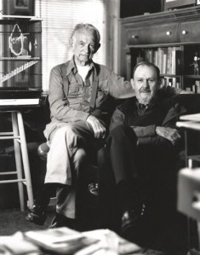
Story of Jeffrey Jeffrey is a 67-year-old man living in a residential care facility. Care staff assumes that he is heterosexual, and that he is no longer sexually interested or sexually capable. The truth is that Mr. McNamara is a bisexual man who continues to be sexually interested and wishes to be sexually active, which is the exact opposite to staff assumptions. When he goes to inform care staff, they were speechless.
John & Fred, 1999 by Richard Renaldi

Slide 35

ACTIVITY
What do you think are the barriers to Jeffrey’s expression of sexuality as well as other older people in care environments?

Slide 36
Issues relating to privacy – building design, surveillance, private rooms
Able partner – availability of an abled partner; one living in the community & the other in a care facility
Physical health – health decline, physical disability, fragility, decrease in libido & dyspareunia
Ageism – rubs off on older people leading to feelings of sexual unattractiveness & abnormality, guilt & decreased desire
Medications – can impact expressions of sexuality & affect sexual function, responsiveness, sensitivity, reaction & ultimately diminish sexual desire

Slide 37
Organisational culture & values
  poor & negative staff attitudes
  poor staff knowledge & awareness
  unsupportive, restrictive & controlling management
  erecting physical barriers (e.g. separation of couple who have lived intimately upon entering a care facility)
  fear tactics (‘If you continue with that sort of behaviour, we’ll have to call your family and most people don’t like that)
  Lack of education = No.1 cause of restrictive organisational culture

Slide 38
Cultural beliefs, values, attitudes, expectations & sensitivity – on the part of both staff & families
Cognitive impairment
  Highly supervised, generally restrained & discouraged due to concerns about consent & safety of the older person
  Lead to a range of different sexual behaviours (reduced sex drive & sexual confusion preventing health expression of sexuality)

Slide 39
MODULE B
Dementia and Expression of Sexuality
Unit I: Sexualities and Dementia in Care Settings

Slide 40
Effects of Dementia on Expression of Sexuality
Onset of dementia gives rise to challenges - expression of sexuality
PWD continue to maintain an interest in intimate & sexual relationships
Some may start to exhibit atypical or uninhibited sexual behaviours including diminished sexual interest, increased sexual demands & the loss of sexual reticence

Slide 41
Example of dementia-related sexual expression:
  Removal of clothing in public
  Exposing & touching their genitals (including masturbating) in public
  Attempting to touch, kiss, hug or flirt with others without the other person’s consent
  Making rude sexual comments that may include swearing
  Requesting sexual acts from residents, staff and/or visitors
  Unwarranted sexual advances towards others
  Unexpected change in sexual orientation or sexual preference

Slide 42
Sexually disinhibited behaviours common in PWD
Dementia-related sexual expression can at times simply reflect the person’s need for touch and/or comfort
Sexual expression by PWD can be appropriate; it may simply be the context that is inappropriate
  For example, a person with dementia who unzips his pants in the corridor may need to use the toilet & another who disrobes in the common living area may be feeling hot or in pain rather than needing to express their sexuality.

Slide 43
ACTIVITY
Mark, a 70-year-old man with frontal lobe dementia, has been found on several occasions taking off his clothes and masturbating at a small entrance hall with stained glass windows and tiled flooring in an aged care facility. What do you think may be happening here?

Slide 44
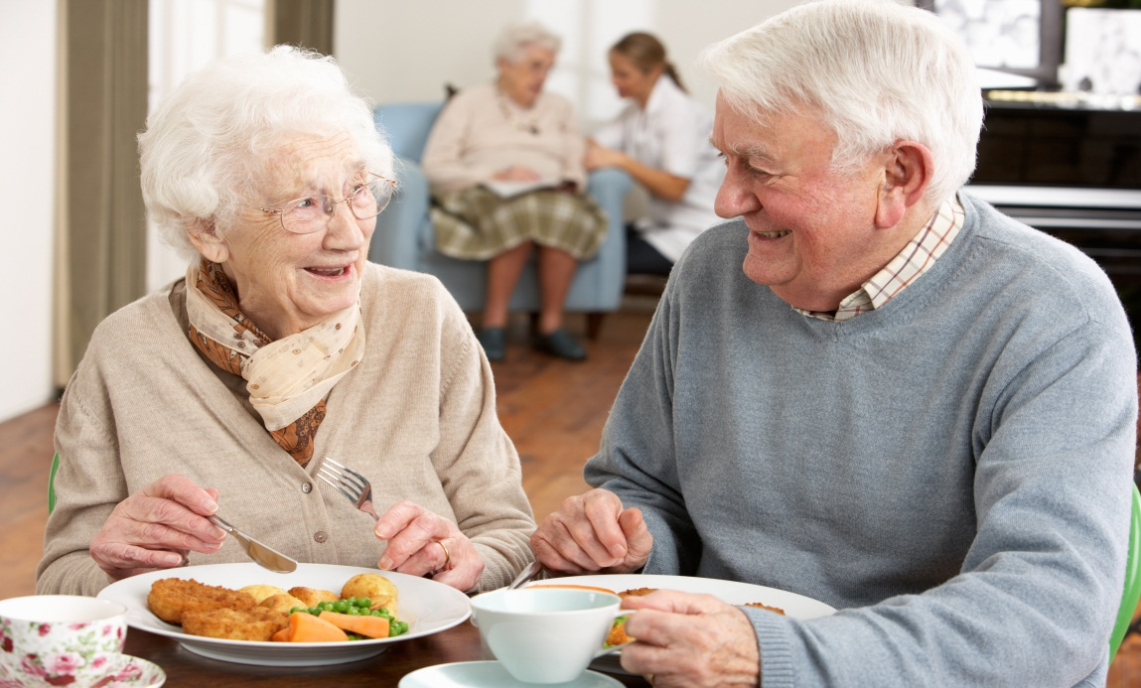
Recognising Signs of Well-Being or
Ill-Being

Slide 45
Story of Elaine Elaine is a 63-year-old widow living with Alzheimer’s disease for the past year. She enjoys socially interacting with other residents in the aged care facility and has a close friendship with one particular resident, Paul. However, care staff recently notice that Elaine seems to be withdrawn and appears rather anxious whenever Paul is around her. When approached by care staff, Elaine first denied anything was wrong but eventually said that Paul has been rubbing his genitals against her body and touching her breast whenever they were alone.

Slide 46
ACTIVITY
What do you think are signs of well-being or ill-being for Elaine

Slide 47
PWD can still agree to participate in sexual activities despite a changed or changing awareness
Capacity to decide to be in a relationship can be ‘decision-specific’ - periods of insight allowing valid decisions on intimacy, sex & relationships
Assent to participate reflected through overall signs of well-being or ill-being

Slide 48
Signs of Well-Being (McCarthy, 2011)
Signs of Ill-Being
(McCarthy, 2011)
can be affectionate
communicates wishes & needs successfully
connects with the people, objects & events around them
engages in creative activities such as painting, singing, dancing
appears to enjoy life
has a positive mood shown by smiling, laughing
has humour & playfulness
is cheerful
is comfortable with physical closeness
is confident
is cooperative with requests
is relaxed in the body (facial expression & body posture)
is sensitive to the emotional needs of others
willingly participates in their own care
makes social contact & shows an awareness of the well-being of others by being helpful
shows enjoyment in interactions & events
shows self-respect in attention to dress & appearance
places trust in others
being agitated and/or restless
being angry and/or aggressive
boredom
grieving & being sad
high levels of body tension
is easily dominated by others
lonely
makes noise, calls out or vocalizes
negative mood (display of distress in facial expression, posture & sounds)
physical discomfort or pain
physically threatens others
rejected and/or ignored by others
showing anxiety and/or fear
signs of lethargy and/or apathy
signs of withdrawal
suspicious of others
unable to enjoy things
verbally refuses care
repetitive movement patterns such as rubbing

Slide 49

Detecting Signs of Sexual Abuse
PWD can experience sexual abuse perpetrated by
a stranger, carer, a family member friend or a spouse
Occurs in many forms
  Not necessary rape
  can be an intentional stimulation of the erogenous zones (nipples, breasts, genitalia) whilst attending to personal hygiene, or when inserting a catheter or applying/changing a continence absorbent aid.
People living with dementia can display revealing physical & behavioural signs of abuse

Slide 50
Physical symptoms
Unexplained bruising or bleeding around the breast, buttocks, lower abdomen, thighs and/or genital areas
Unexplained visual signs of a sexual health infection
Walking difficulties, pain when sitting and/or obvious genital trauma
Behavioural symptoms
Sudden reluctance to be undressed, changed or bathed
Sudden mention of sexual acts
Sudden agitation when being changed or continence pads are being fitted

Slide 51

Suspicion or observed misconduct signalling sexual abuse should be immediately reported to management!

Slide 52
Identifying Sexual Risks to Vulnerable People with Dementia
May not be possible or desirable to entirely eliminate sexual risk
Alzheimer’s Australia - risk management requires weighing up the safety, freedom & rights of people in care
  Does the sexual risk outweigh the benefits of the sexual behaviour/relationship for the PWD?
  Does the sexual behaviour/relationship of the person with dementia infringe on the rights of others?

Slide 53
Diminished mental capacity to consent for PWD – challenging issue
PWD have rights to make decisions about their sexualities, intimacy & physical relationships
Tarzia et al. (2012) proposed the adoption of a sexual decision-making framework for PWD with pursuit of happiness as its guiding principle.
Common sense approach & observing the interactions of PWD may be more appropriate & beneficial rather rushing to initiate mediation or capacity assessment when sexual behaviour is encountered

Slide 54
Awareness of Relationships
To what extent is the person with dementia capable of making his/her own decisions?
Does the person with dementia have the ability to recognise the person with whom he/she is having the relationship? Could he/she have mistaken, for example, said individual for his/her original spouse/partner?
Can the person with dementia understand what it means to be physically intimate?
Ability to Avoid Exploitation
What is the person’s ability to avoid exploitation? Does he/she have the capacity to say ‘no’ to unwanted sexual contact?
Is the person with dementia capable of expressing his/her views & wishes within the relationship through either verbal or nonverbal communication?
Awareness of Potential Risks
How may the person react or be affected if he/she is ignored, rejected after intimacy or the relationship ends?
What is the person’s ability to understand future sexual risk? Lichtenberg & Strzepek (1990); Lichtenberg (1997)

Slide 55
Broader Ethical Considerations
1. Is the behaviour in keeping with the person with dementia’s past values, beliefs and/or religious views? If not, but the person with dementia appears content & happy, to what extent should it matter? (Sokolowski, 2010, 2011 & 2012)
2. To what extent do care providers have the ‘right’ to intervene in the sexual lives of PWD? What rights of PWD are being denied when such interventions occur? (Sokolowski, 2010, 2011 & 2012)
3. To what extent should others be allowed to make decisions about the relationship of PWD? (Sokolowski, 2010, 2011 & 2012)
4. How do you balance the safety of PWD while also empowering them to live their lives?
5. Have family & spouse/partner been informed by staff & aware of the new relationship?
6. If there is a spouse/partner living outside of the care home, is he/she aware of the new relationship? How will he/she feel about the new relationship?
7. Does the family or spouse/partner feel comfortable in expressing their views about the new relationship?
8. To what extent should the views of family or spouse/partner be taken into consideration if they are unhappy with the relationship?

Slide 56
Types of sexual risk
  sexually transmitted infection
  trauma or physical damage
  emotional upset
Communication vital to sexual risk identification
Caution: prohibiting sexual activities due to fear of sexual risk
  peril to the well-being of PWD
  an abuse of their rights
Best prevention is to be well informed & prepared

Slide 57
MODULE B
Dementia and Expression of Sexuality
Unit II: Caregivers’ Role and Responsibilities in the Expression of Sexuality by People with Dementia

Slide 58
Roles & Responsibilities Towards the Expression of Sexuality
Read & be aware with any relevant organizational policy & guidelines (if any)
Right to self-expression & self-determination needs should be balanced against a ‘prevention of risks is best’ approach
Assist PWD to meet their need for expression of sexuality – sensitively, professionally & with respect to the dignity

Slide 59
Pre-existing & new developing relationships in care environments should be supported
While “to the outside world it may seem uncomfortable or odd at first sight for a sexual or intimate relationship to continue when one partner has dementia...many couples do wish to maintain some level of intimacy and any problems can be handled and successfully navigated within the relationship” (Bamford, 2011; pg. 15) with the right approach.

Slide 60
‘Inappropriate’ sexual expression,
  re-direct into more appropriate channels
  find ways to help a patient/resident meet their sexual needs.
  For example: promoting activities, like social outings, beauty services & romantic evenings can all enhance a resident’s sense of self & beauty, which also re-channels sexualities into more context-appropriate behaviour
Note: Ascertaining the ‘appropriateness’ of sexual expression may lead to questions of consents (as discussed during Day One Workshop)

Slide 61
Responding to the Expression of Sexuality by People with Dementia
Many productive ways to respond
Normal & natural for PWD to have sexual needs – respect feelings & dignity of PWD; respond with sensitivity & empathy
Examples:
  Provide privacy for masturbation & reading/watching pornographic materials (placing a “do not disturb” sign on the door of their room)
  Engaging the services of erotic body masseur & sex workers

Slide 62
Assessment of the sexual behaviour & whether it is a cause for concern is the first step
Rules of Thumb
If PWD can make some, but not all behavioural decisions, they should still retain their rights to make as many decisions as possible without interference. If their consenting ability or the behaviour are questionable, or family members disagree, it may then be a cause for concern requiring assessment.

Slide 63
Rules of Thumb
If the behaviour is deemed ‘inappropriate’ because it poses serious risk to themselves or others, an immediate (i.e. on-the-spot) response may be necessary. When this occurs, staff needs to remain non-judgemental, calm & objective.

Slide 64
Strategies care staff can employ include:
Try to remain calm, try not to feel embarrassed or show shock.
Remember to be respectful to the person with dementia & try to preserve his or her dignity.
Try to remember that the person with dementia may have no awareness that his/her behaviour is inappropriate or shocking in any way.
If others are present, & the behaviour is inappropriate, try to reassure the patients/residents or families present that the patient/resident with dementia means no harm.

Slide 65
Strategies care staff can employ include:
Depending on the situation, if the behaviour is taking place in a communal area, try to distract the patient/resident with dementia & lead them away.
Appropriate jokes, witty replies & humour can sometimes be used to respond to some forms of sexual behaviour. It needs to be done tactfully & with respect to the patient/resident, staff & visitors.

Slide 66
Even if the expression of sexuality is deemed ‘inappropriate’ because of risk & an increased in frequency, before introducing any intervention, a methodical assessment to identify underlying causes of sexual behavior should first be conducted.

Slide 67
Bamford (2011); Series & Degano (2005): 1. What form does the behaviour take?
In what context? Potential environmental triggers? How frequently does it take place? Review the behavioural history & current routine of the person with dementia. If staff has not already done so, they need to speak to the family, friends or spouse/partner of the person with dementia to gain a greater understanding of his or her social & sexual history.

Slide 68
2. What factors may contribute to the behaviour? Could there be a social, environmental, medical or psychological cause?
Has there been a change to the routine or environment of the person with dementia? For example, sometimes a lack of privacy can force patients/residents to express sexual behaviour in an overt fashion. Is it possible that the person with dementia is misinterpreting the actions of, for example, the care worker or believes them to be someone else he/she knows well or intimately? Have you checked the person with dementia has no underlying medical condition, which may be contributing to this behaviour? Or that his/her medication has been changed? For example, urinary or vulva/vaginal problems may lead to increased touching. Have you assessed the mental well-being of the person with dementia? Could he/she be depressed, experiencing delirium, be manic, or simply feeling lonely & looking for reassurance, comfort, or touch? If the person with dementia is trying to take his/her clothes off, is it because he/she is wearing an item of clothing that is irritating them or simply too hot?

Slide 69
3. Reflect on how you define & classify inappropriate behaviour
Consider how you have formed this judgement & try to work out if the behaviour offends your attitudes, cultural or religious beliefs or values. Or do you find the behaviour inappropriate because you feel it would be judged so by other staff members, patients/residents or maybe the patients’/residents’ family?
4. Consider what risks are involved
Does the person with dementia pose a risk others? A risk to themselves? Or to the wider residential community? Try to assess the awareness & understanding the person with dementia has of his/her behaviour. Make sure you report & record any behaviour that may be inappropriate.

Slide 70
P-LI-SS-IT Model of Care (White, 2011)
An useful model to guide sexual discussion with primary carers of PWD to not only gain an understanding of the person with dementia’s sexual history & behaviours but also proactively offers the family an opportunity to discuss their concerns

Slide 71
P-LI-SS-IT Model of Care (White, 2011)
PERMISSION | Gain family permission to discuss sexual behaviour of their loved one.
LIMITED INFORMATION | Provide information on how the process of dementia may impact on a person’s sexuality, continuance of sexual desire & benefits to well-being to maintain intimate contact with loved ones or form new relationships.
SPECIFIC SUGGESTIONS | Offer suggestions on caring for the sexual needs of PWD: sensory therapies (remedial massage, aromatherapy, music); inviting spouse or partner to stay overnight or to take the person living with dementia home for occasional overnight stays (if they are in residential care); & asking family to ensemble an autobiographical account of the person’s life with photos & reminders of good times to be used in later reminiscence-distraction programmes.
INTENSIVE THERAPY | Advise family on the availability of counsellors, community support groups, sex therapists, psychologists, social workers or clinical nurse consultants that may be able to help family work through their own feelings & obtain support.

Slide 72
Case of Paul & Margaret Holmes 71-year-old Paul was diagnosed with Alzheimer's disease. He had been living in a dementia specific unit for approximately the last two years. His wife, Margaret (63-year-old), visits him on a daily basis. She was upset by his constant desire to engage in sexual intercourse.

Slide 73
ACTIVITY
  How can the ‘P-LI-SS-IT’ model of care be applied in the case of Paul & Margaret Holmes?

Slide 74
Case of Paul & Margaret Holmes Noticing Margaret's discomfort, care staff sought her permission to discuss the situation. While Margaret was initially reluctant to discuss the situation, she eventually confided in the care staff. When questioned about their sexual history, Margaret indicated that she and Paul had an active sexual life right up till his admission to residential care. She was concerned that Paul, given his Alzheimer's disease, may not be fully aware of his own actions (i.e. taking off his clothes, pulling her into the bed with him and touching her intimately). She was also particularly worried about the attitudes of other people and that if she agreed to his sexual advances, they would know what she and Paul were doing behind closed doors. Margaret felt embarrassed about the possibility of others laughing at them having sex at their age. Given her concerns, suggestions were made for Margaret to meet with a clinical nurse consultant in regular formal sessions to discuss her feelings of concerns. During these 'intensive therapy' sessions, it was noted to Margaret that the behaviours exhibited by Paul were not unusual from those prior to his admission to the care facility. Margaret was reassured that, in light of their active sexual life, it was quite normal for Paul to continue having and displaying sexual needs and desire. The clinical nurse consultant suggested that Margaret should consider taking Paul home for a night stay-over to once again share feelings of intimacy and have sex in the privacy of their own bedroom. This suggestion was proven to be a success for Paul and Margaret where home overnight stay was organised on a regular basis.

Slide 75
Needs-based approach (White, 2011 & McCarthy 2011) – identify triggers to sexual behaviour in PWD & adopt care practices to meet their sexual needs
Plan action
Implement the plan
Addressing the education needs of staff, residents or family regarding sexual behaviour as they arise
Evaluate the effectiveness of the intervention
Step 3
Step 4
Step 5
Step 6
Step 2
Identify the unmet needs including internal (sexual desire) & external (environmental, sights, activities etc) triggers.
Step 1
Identifying the risk/ ‘problem’ behaviour

Slide 76
Responding to Sexual Advances from People with Dementia
PWD may
  confuse health care professionals for intimate spouse/partner
  misinterpret the meaning of certain words or actions, especially during personal care activities like dressing or showering/bathing
  Response Strategy: clearly identify the behaviour & indicate that the behaviour is unacceptable & you feel uncomfortable while reminding the person with dementia who you are

Slide 77
In acute dementia (i.e. delirium), words will be generally be ineffective
Remove yourself from the situation & seek help if you:
  cannot distract the person
  unable to re-direct his/her behaviour to another activity
  unable to move the resident to another location & his/her behaviour is placing you at risk

Slide 78
Following an incidence of uninvited sexual advance, it is normal for to feel upset, angry and/or emotional
Important to seek support & reassurance from your colleagues
Report & record the incidence - allow a thorough assessment to determine the triggers of the behaviour & identify possible ways to avoid or limit future sexual advances

Slide 79
MODULE C
Ethical Considerations: Policy/Guidelines
Development for Sexualities and Dementia in Care Setting

Slide 80
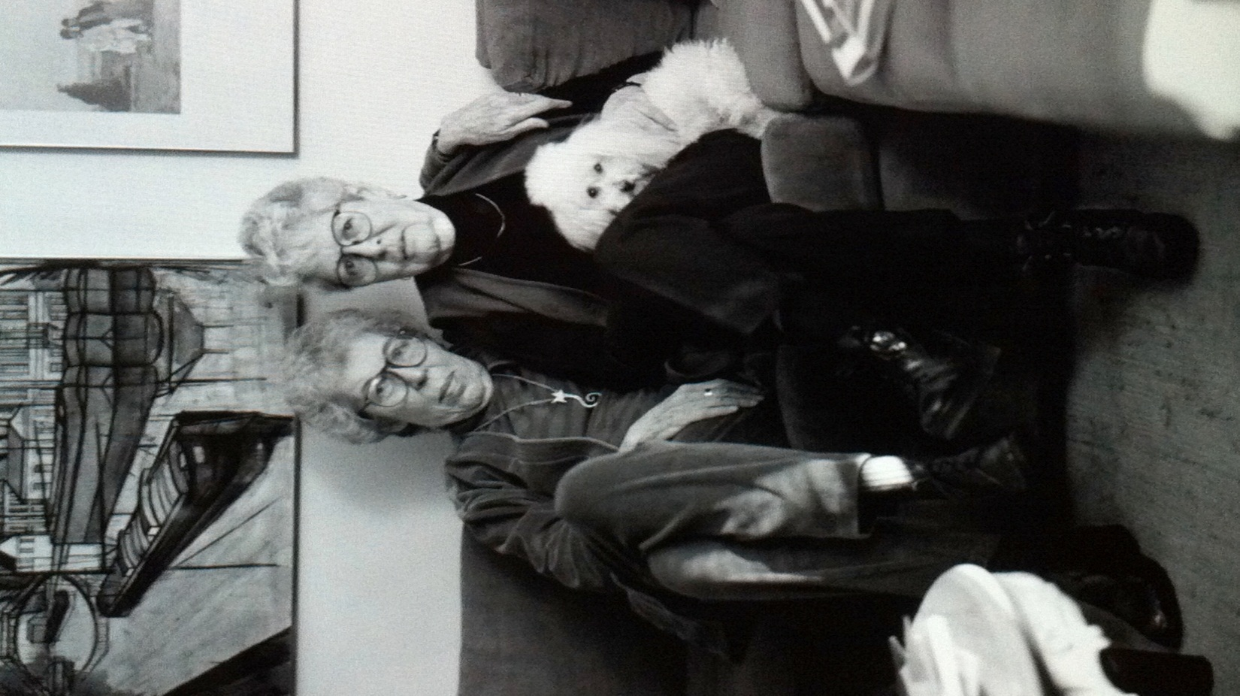
The Story of Valarie & Linda
Valarie is a 69-year old widow with mid-stage Alzheimer’s disease. She has been residing in a long-term care facility for the past 2 years, after the death of her husband of 48 years. Valarie often does not recognise her 2 adult children who visit her regularly. Linda is a 73-years-old single female with early stage Alzheimer’s and a history of same-sex relationships prior to her admission into the long-term care facility a year ago. Her younger brother visits her regularly. Despite displaying some signs of memory loss and associated distress, she is very sociable and loves interacting with other residents. Six months ago, Valarie and Linda started spending time together. They ate their meals and attended activities together. Three weeks ago, they were found sitting together in Linda’s bed, kissing and fondling each other by an attending nurse who entered their room without knocking.
Case study adapted from Sokolowski, M. (2010 & 2011) Sexuality and dementia in long-term care: Ethical issues.
© Gay & Lesbian Elderly Series by Richard Renaldi

Slide 81

REFLECTIVE QUESTION:
What are your beliefs, values, moral codes & cultural attitudes regarding the relationship as outlined between Valarie & Linda? Consider if such beliefs, values, moral codes & cultural attitudes may contradict your professional beliefs & influence your professional role & responsibilities when caring for Valerie & Linda.

Slide 82

Staff’s Reaction
Although the nurse quietly retreated from Linda’s room, she felt uncomfortable with the relationship. She is also concerned about the possible relational exploitation by Linda given Valarie’s cognitive state of capacity. The nurse reported the incident to her supervisor, who then discussed the matter with the facility manager. It was decided that both families should be informed of the relationship.
Adapted from Sokolowski, M. (2012) Sex, dementia and the nursing home: Ethical issues for reflection.

Slide 83

Valarie’s Family (Children) Reactions
Valarie’s daughter was aghast by the relationship and felt that her mother was being taken advantage of. She indicated that not only is Valarie heterosexual, who had a loving and happy marital relationship with her father, and that Valarie would be “dismayed” if she could really appreciate her behaviour. Valarie’s daughter insisted on separating her mother from Linda.
On the other hand, Valarie’s son, while surprised, noted that his mother seemed much happier than before she had dementia and wondered if perhaps she is now enjoying living a somewhat different life with different values.
Adapted from Sokolowski, M. (2012) Sex, dementia and the nursing home: Ethical issues for reflection.

Slide 84

Linda’s Family (Brother) Reactions
Linda’s brother was happy that his sister has developed a new relationship. He felt that she knew what she is doing and it’s nobody’s business but hers!
Adapted from Sokolowski, M. (2012) Sex, dementia and the nursing home: Ethical issues for reflection.

Slide 85
Impact on Family
What impact does this relationship have on both Valarie & Linda’s families?
Impact on Others
Is the privacy of other residents being invaded? Are other residents being negatively affected in other ways?
Impact to Organisations
Is there the possibility of a lawsuit from Valarie’s family?
Valarie’s daughter is negatively affected by this relationship as her reactions include concerns about her mother’s safety & values. While Valarie’s needs ought to be privileged, is there also a need to mitigate & significantly reduce her daughter’s concerns?
What impact does this have on staff? Are they equipped to deal with this? Do they require additional supports to deal with their own competing values?
Could such a relationship tarnish the organisation’s reputation?
Does the disclosure of the relationship impose a breach of trust of residents, staff, family & community?
Above content adapted from Sokolowski (2010 & 2011)

Slide 86
Care Staff are:
  to abide by the codes of ethics & conducts
  governed by the established standards & values in the 1997 Aged Care Act
  uphold organisational values reflected in the philosophy of care, mission statements & position statements.
As a result of the legalities of duty of care, health care professionals often take on an approach emphasising risk prevention

Slide 87
Challenging to define & measure risk & understand the different experiences of it for all the stakeholders involved
Difficult to ascertain as well when the risks may override the benefits (& according to whom)
Judgments are influenced by value system, the society norms, attitude toward sexualities & workplace policy or guidelines

Slide 88
Lack of policy or guidelines to deal with such matters lead to an experience of dissonance for health care professionals
People with cognitive disability
  reduced freedom of choice
  increased supervision & control
  so pervasive that PWD are deprived of their basic human rights to decision-making when it comes to the expression of sexuality

Slide 89
Aged care facilities operated by religious affiliated organisations
  values may negatively influence any support for expression of sexuality including same-sex relationships such as the relationship between Valarie & Linda

Slide 90
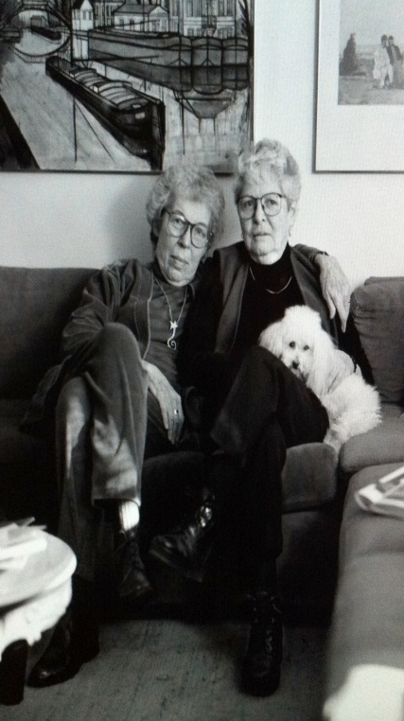
Privacy Rights
Autonomy & Solidarity
Cognitive Capacity
& Consent
© Gay & Lesbian Elderly Series by Richard Renaldi
Personhood

Slide 91
Privacy Rights
Australian Commonwealth Government - Charter of Resident’s Right & Responsibilities, the User Rights Principles, under the Aged Care Act
  right to personal privacy
  right to select & maintain social & personal relationships without fear, criticism or restriction
  stipulation being as long as it does not inflict damage to property or impinge on the rights of others or negatively affect the well-being of others

Slide 92
“They may lose the ability to ive independently. They do not lose their rights”
(Field & Garratt, 2004, p.75)
Issue of Privacy Rights
Did the management of the aged care facility breach the privacy rights of Valarie & Linda by contacting their families?
Adapted from Sokolowski
(2010 & 2011)
Under the amended Charter of Resident’s Right & Responsibilities, the User Rights Principles, of the Aged Care Act (1997), shouldn’t Valarie & Linda be entitled to:
Do you think the staff & management of the aged care facility have responded too quickly & emotionally & are likely to inject their own personal values on the same-sex relationship?
Adapted from Sokolowski
(2010 & 2011)
personal privacy?
personal relationships without fear, criticism or restriction?

Slide 93
Cognitive Capacity & Consent
Content from Sokolowski (2010 & 2011)
Consent to be involved in a sexual relationship = consent to a medical treatment?
Cognitive capacity (i.e. ability to perform a task or make a decision) is understood as to be similar or even interchangeable with autonomy (i.e. privileges of self-determination/self-rule)

Slide 94
> Cognitive capacity is diminished - less attention to the wishes of the person
  morally incorrect
  encroaches on the autonomy & dignity of the PWD (Post, 2006 & O’Neill, 1997)
PWD still capable of experiencing meaningful relationship
PWD are able to understand in a general way what it means to engage in a sexual relationship or activity

Slide 95
Avoid rigorous assessments
Avoid imposing any unrealistic expectations relating to their understanding or appreciation
People often enter into sexual relationships without much rational thought at all. So why do we expect something different of those with dementia?
Sokolowski (2010 & 2011); Gordon & Sokolowski (2004)

Slide 96
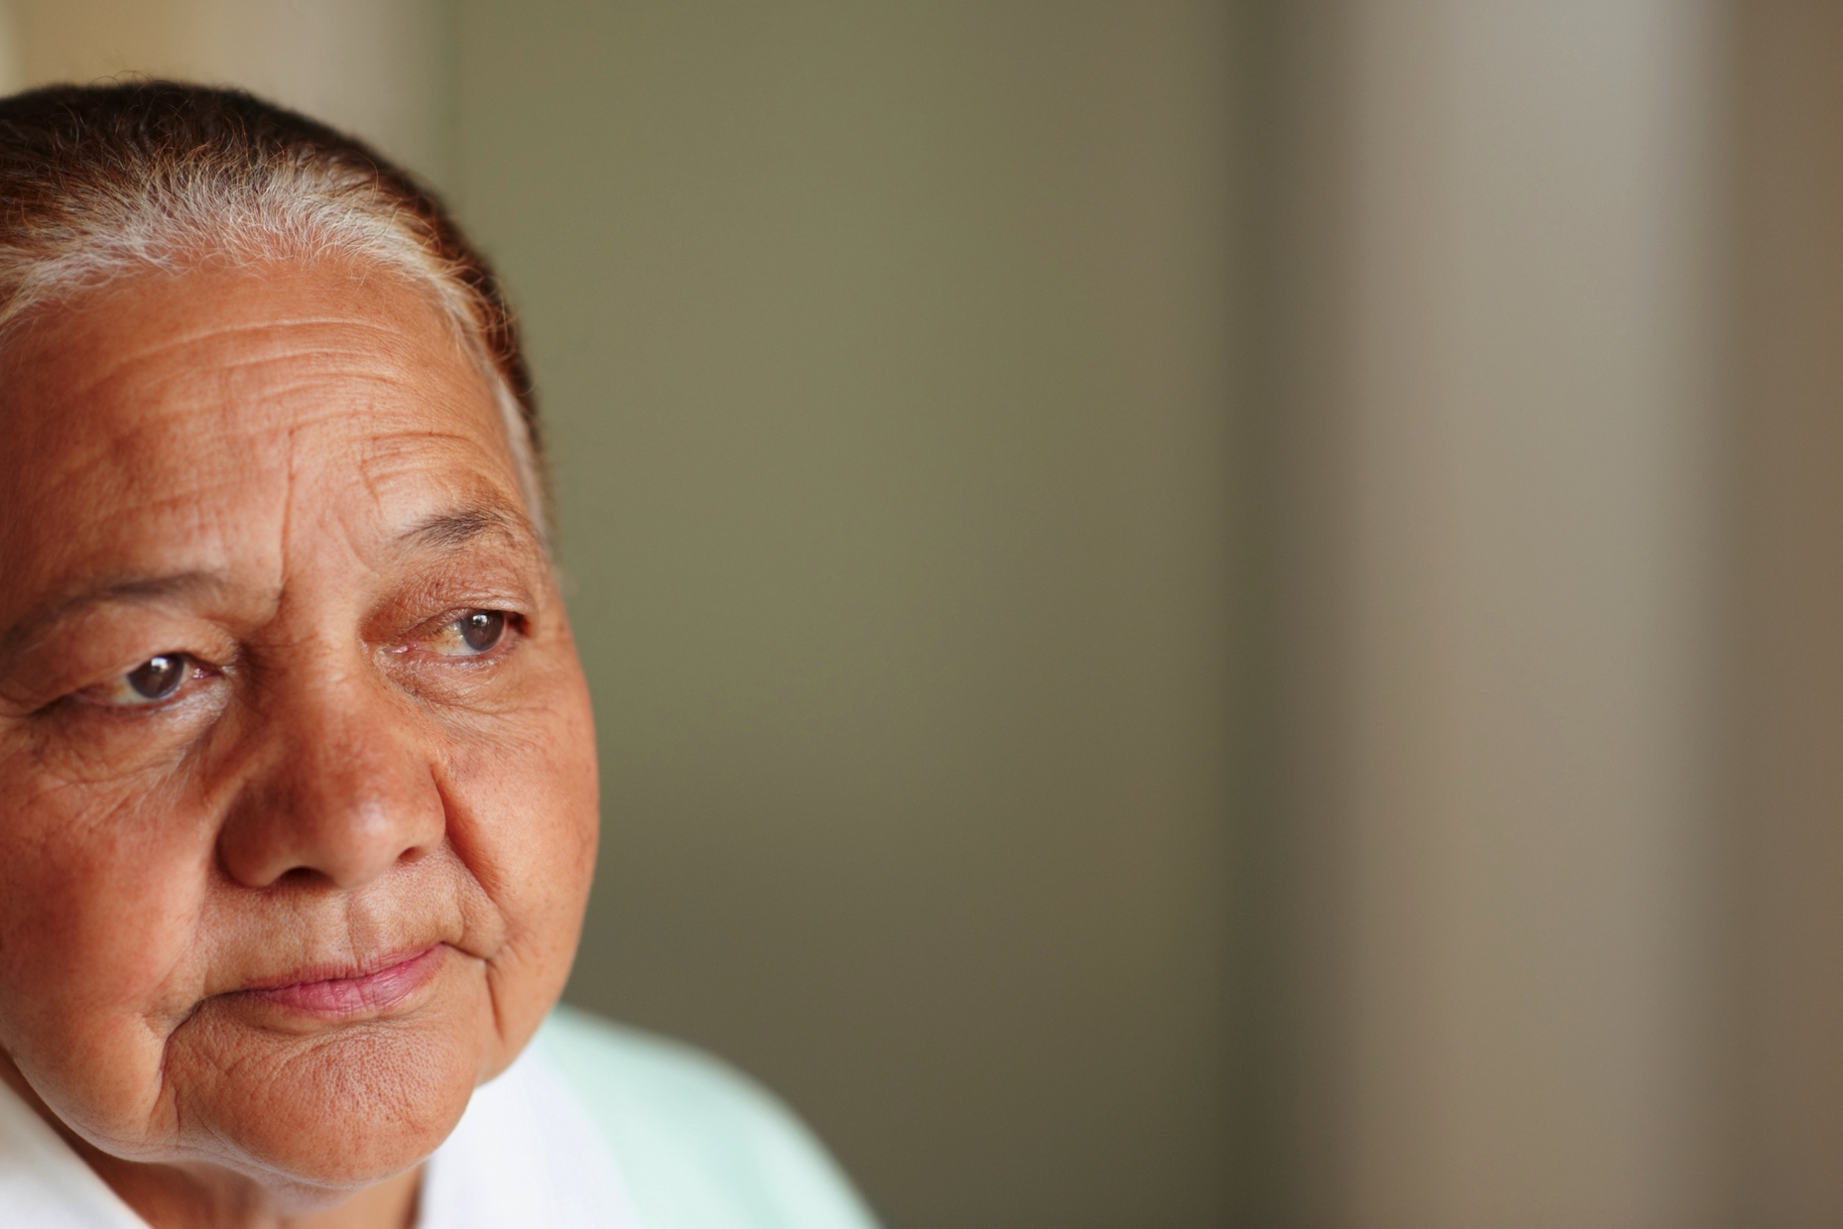
If we were to believe that Valarie & Linda could not “pass the competency to consent” test, they could probably assent to participate in their relationship (agree without full understanding). Wouldn’t that be enough?
Adapted from Sokolowski (2010 & 2011)

Slide 97
Autonomy & Solidarity
Content from Sokolowski (2010 & 2011)
Conventional view
  heavy reliance on one having a requisite intellectual level (Dodds, 2000)
  connected to what one wants or prefers prior to dementia
  no longer pertinent in the context of dementia.
  Thus limited consideration is given to the older person’s existing sexual desires & wishes, which can, in fact, also be a true reflection of his or her autonomy

Slide 98
Medical perspective: autonomy - dichotomous (i.e. able or unable)
  impractical
  does not reflect the reality of PWD possessing fluctuating abilities to govern themselves in different contexts & act according to the values & beliefs that are important to them

Slide 99
Autonomy for PWD
  not static but dynamic & flexible
  one becomes less autonomous overall as dementia progresses
  wrong to assume PWD can no longer be autonomous (Fellows, 1998; Sokolowski, 2010 & 2011)
  more beneficial & pragmatic to consider autonomy as existing on a continuum (i.e. more or less autonomous)
  associated with values & beliefs
  linked to the social, emotional, religious & spiritual realms of identity

Slide 100
Not only can PWD still retain an interest in certain values & beliefs that shape how they wish to live their lives, but more importantly, new & different values can still conceivably be created (Fellow, 1998 & Jaworska, 1999).

Slide 101
Duty to support those unable to support themselves
PWD need to be empowered & given a voice
Promoting & sustaining social justice, which is at the root of our notion of solidarity, must be realised as a willingness to support PWD in their expression of sexuality throughout the course of their dementia & to help them in maintaining their autonomy as much as possible

Slide 102

Adapted from Sokolowski (2010 & 2011)
In the absence of their usual decision-making cognitive skills, do Valarie & Linda demonstrate, through their ongoing relationship & desires to seek out each other’s company, that they value companionship & physical intimacy?
Should we acknowledge & support their desires for friendship & physical intimacy?
Is it conceivable that the same sex relationship, which Valarie is involved in, may either be a reflection of her new values or perhaps her past dormant values unknown to her family?
More autonomous…
Less autonomous…

Slide 103
Personhood (‘Now’ vs. ‘Then’)
Content from Sokolowski (2010 & 2011)
Debate: privilege the values, beliefs & wishes of the person before dementia (i.e. “then” person) or after dementia (i.e. “now” person) in sexually related matters? (Dresser, 1995; Dworkin, 1993)
Propensity to devalue the current sexual needs & behaviours (i.e. “now” person) & consider the previous behaviours displayed by the person prior to their dementia (i.e. “then” person) as ‘authentic’
“She is acting out of character.”
“She would be so ashamed if she really knew what she was doing now!”
Sokolowski (2010 & 2011); Gordon & Sokolowski (2004)

Slide 104
Favouring the “then” person
common creed that one has a relatively unified life with fixed & stable values
behaviours that are a reflection of the “authentic” self
deviations from usual or “normal” behaviour = pathological (Kuczewski, 1999)
But what if ‘personhood’ can authentically change? Possibly viewed as a healthy way to connect with others…
Gordon & Sokolowski (2004); Archibald (2003); Schwatrz, Myran & Sokolowski (2007)

Slide 105
Changes in personality
  character, behavioural, temperamental, emotional, & mental traits (Robins-Wahlin & Byrne, 2011)
  prominent in PWD when brain damage is primarily located in the frontal lobe (Alzheimer’s Australia, 2005)
The deliberation lies in whether the new personality should be regarded less favourably simply because the older person displays different traits to their past life.

Slide 106
Kitwood (1997):
  PWD can maintain their ‘personhood’ through relationships with other people
  Personal & social identity of PWD arises out of what is said & done with them & there is an ethical obligation to treat PWD with respect
Seem logical to neither dwell on the process leading to the change of personality in older people nor refute the genuinity of the new personality & the associated expression of sexuality - Acknowledge & Respect

Slide 107
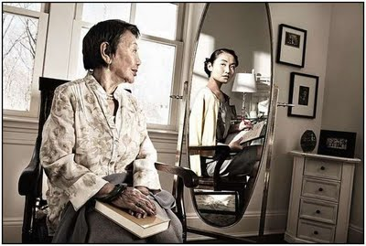
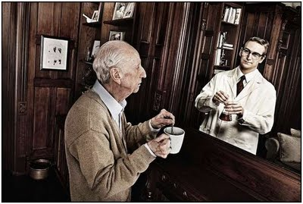
Do you think it is probable that Valarie’s values can authentically change? If yes, it is possible to view her behaviour differently, perhaps as a healthy way to connect with others?
While some may view Valarie’s behaviour to be pathological & should be stopped, is it possible that personhood is not fixed?
‘NOW’ Person vs. ‘THEN’ Person
http://foranyeyes.blogspot.com.au/2011/08/mirror-and-perpetual-shock-of-aging.html
Adapted from Sokolowski (2010 & 2011)
http://foranyeyes.blogspot.com.au/2011/08/mirror-and-perpetual-shock-of-aging.html

Slide 108
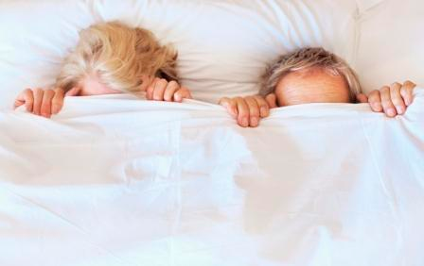

Ageing, Dementia & Sex Workers
An 80-year-old nurse is on a crusade to raise awareness about the sexual needs of people with dementia, and the necessity for them in some cases to use sex workers. Sex worker Rachel Wotton features in the documentary Scarlet Road, and hopes by speaking out she can break down the stereotypes and popular misconceptions held about people with disabilities and their sexuality. Ms. Wotton, along with fellow sex workers Saul Isbister, established the charity Touching Base, which helps people with a disability - including those with dementia - access the services of sex workers.
Abstract obtained from online article “Nurse campaign for sexual needs of dementia patients” by Rebecca Baillie www.abc.net.au/news/2013-03-19/dementia-sex-human-rights-nurse-campaign/4582770

Slide 109
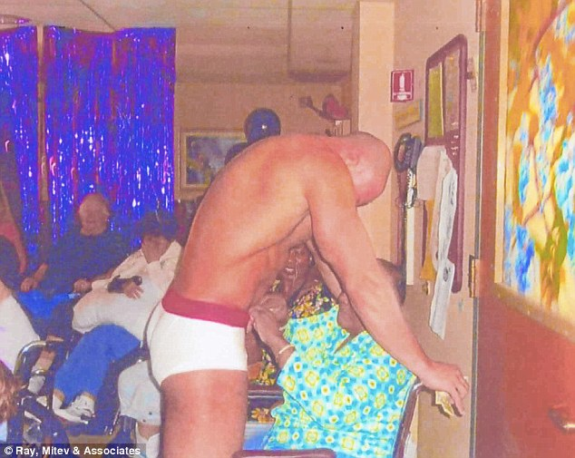
Stripper at New York nursing home
leads resident's son to sue

Slide 110
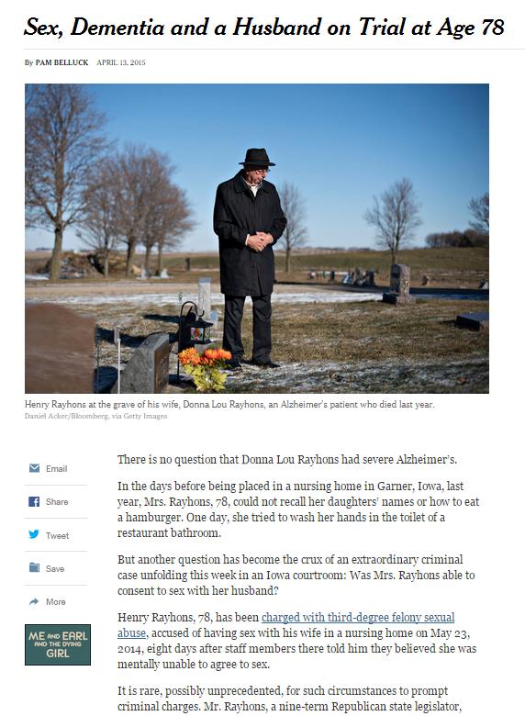
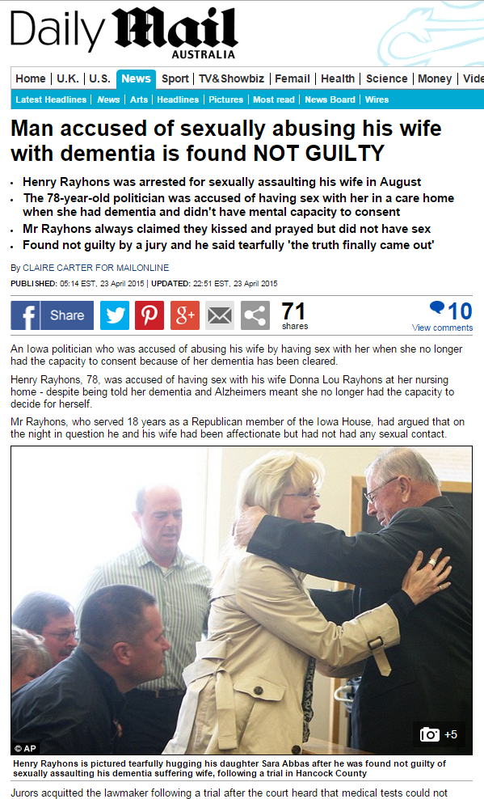
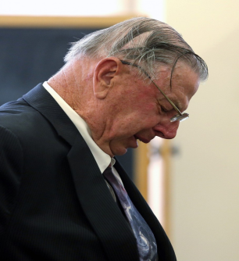

Slide 111
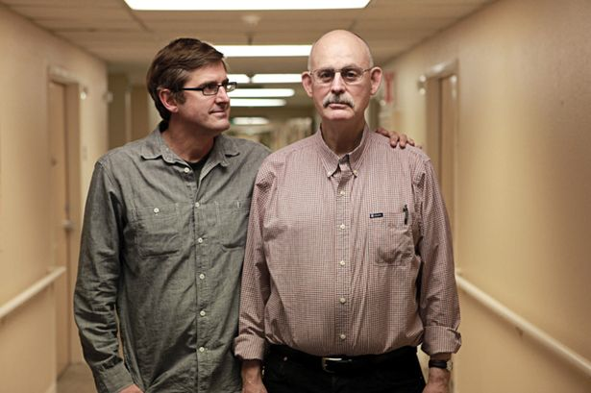
Extreme Love: Dementia Love (Louis Theroux)
69-years-old Gary Gillian, who used to be a dentist, lives in the institution still thinking he practices his profession. Like many other residents, he does not realise that his stay there is permanent and that he cannot leave. Gary is married to Carla. He however does not remember his wife anymore but thinks she is just a business partner. Garry has two special lady friends: Betty “a very possession lady friend” & Pat “more normal” – as described by Carla…

Slide 112

CONCLUSIONS

Slide 113
SEXUALITIES & DEMENTIA (10 KEY POINTS)
1. Confront your own values, attitudes & behaviours towards sexuality & older people.
2. People continue to be sexual beings with the capacity & a need to express their sexualities regardless of age & cognitive disability.
3. Expressions of intimacy & sexualities have positive physical, psychological, intellectual & social benefits for individuals including PWD.
4. Not all PWD are heterosexual.
5. Dementia-related sexual behaviours can, at times, simply reflect the person’s need for touch and/or comfort. Adopt a psychological needs based approach when addressing the expressions of intimacy & sexualities for PWD.

Slide 114
SEXUALITIES & DEMENTIA (10 KEY POINTS)
6. No standard response to sexual behaviours of PWD. Assess each case on an individual basis.
7. People with dementia can continue to have the capacity to make decisions about their sexual needs & behaviours.
8. Besides the cognitive capacity for consent, consideration should also be given to the issues of privacy, autonomy, solidarity & personhood.
9. Familiarise yourself with your organisation’s policy on dementia & sexualities (if there is one).
10. Communicate – Have an early open dialogue with your residents, family carers, colleagues & management on this subject.

Slide 115
“People’s desires & preferences respond to their beliefs about norms & about their own opportunities. Thus people usually adjust their desires to reflect the level of their available possibilities”
(Nussbaum, 1999)

Slide 116

Workshop Evaluation

Slide 117
Thank you for your participation
End of Workshop

